Slide 1
Social Emotional Learning (SEL):
A Comprehensive Introduction
Version 3 June 2022
Notes:
Resources:

Slide 2
WARNING: CONTENT OF THIS PRESENTATION MAY NOT BE SUITABLE FOR CHILDREN. CONTAINS SEXUALLY EXPLICIT CONCEPTS AND MATERIAL.
Notes:
Resources:

Slide 3
Mission: Educate parents and taxpayers about national trends in education, to include local implementation, in a factual and forthright manner
Notes:
Resources:

Slide 4
Vocabulary and Themes
Equity: Equal Outcomes vs. Equality: Equal Opportunities
Just Society: A society that is fair to all, especially minorities; belief that society currently is unjust
Identity: How one identifies one’s self; generally used in terms of sexual and gender identity
Common Good vs Individual Excellence
Redistribution of Wealth
Government Authority Superseding Parental Authority
Arrogance, Self as God
Lived experiences vs. fact and logic
“Evidence-based, Age appropriate”
Notes:
Resources:

Slide 5
Vocabulary and Themes
MARKETING VS. REALITY
YOU MUST BE ABLE TO SEE PAST THE MARKETING AND EDUCATE YOURSELF TO THE REALITY!!!
Notes:
Resources:

Slide 6
Vocabulary and Themes
Governments are increasingly focused on mental health
CDC Whole School, Whole Community, Whole Child Initiative
“The WSCC model is student-centered and emphasizes the role of the community in supporting the school, the connections between health and academic achievement and the importance of evidence-based school policies and practices.”
1.28

Slide 7
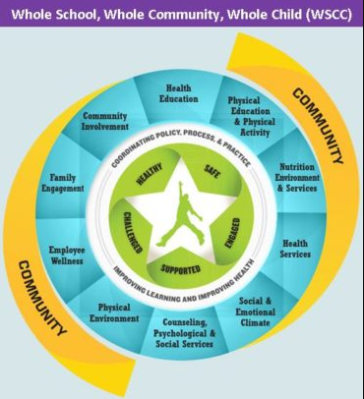
Vocabulary and Themes
Physical education and physical activity
Nutrition environment and services
Health education
Social and emotional climate
Physical environment
Health services
Counseling, psychological and social services
Employee wellness
Community involvement
Family engagement
1.28

Slide 8
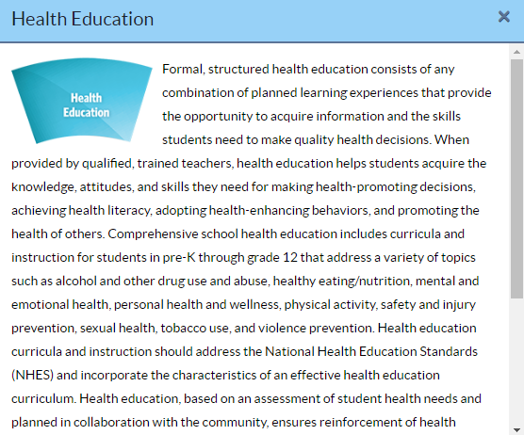
Vocabulary and Themes
1.28

Slide 9
Social Emotional Learning
CASEL
Critical Race Theory
Panorama Survey Tool
Comprehensive Sexual Education
Second Step
BrainPop
Sanford Harmony
7 Mindsets
ReThinkEd
Notes:
Resources:

Slide 10
Social Emotional Learning (SEL)
Background
Funding
Marketed vs. Reality
Examples
Implementation in Columbia County
Concerns/Questions
Notes:
Resources:

Slide 11
Social Emotional Learning (SEL)
Quick Summary Video
1.24

Slide 12
Social Emotional Learning (SEL)
Background
“The process through which individuals learn and apply a set of social, emotional, behavioral, and character skills required to succeed in schooling, the workplace, relationships and citizenship."
One definition of many; no standard definition
1.24

Slide 13
Social Emotional Learning (SEL)
Background (continued)
1960’s-Modern SEL founded by Yale psychologist and researcher James Comer
Pilot Program in New Haven, CT found great success
Combined supportive community, student social/psychological well-being, and academic progress
Guiding principles: collaboration, consensus, no-fault problem solving
setting aside emotions to focus on facts and solutions
1.14, 1.16

Slide 14
Social Emotional Learning (SEL)
Background (continued)
1994-Collaborative to Advance SEL (CASEL) was founded
1995-SEL publicized through book “Emotional Intelligence-Why it Can Matter More than IQ” written by Daniel Goleman and John Fetzer
John Fetzer-electrical engineer with spiritual curiosity
The Fetzer Institute
Be aware: Original SEL is NOT new SEL
Transition has been gradual, but new definition has been implemented
1.14, 1.26

Slide 15
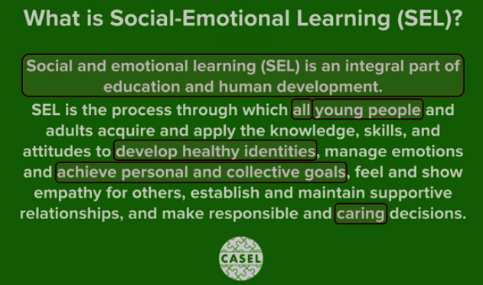
Social Emotional Learning (SEL)
Background (continued)
Be aware: Original SEL is NOT new SEL (Updated 2020)
2.6

Slide 16
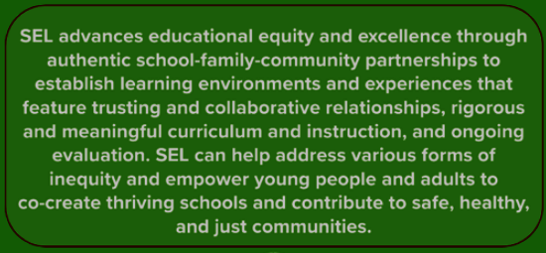
Social Emotional Learning (SEL)
Background (continued)
Be aware: Original SEL is NOT new SEL (Updated 2020)
2.6

Slide 17
Social Emotional Learning (SEL)
Funding
The Fetzer Institute-Foundational Questions:
How can insights of science and the power of technological innovation be utilized to explore the capacities of the mind and spirit?
How can the wisdom and insight gained through inner exploration be used to better our individual and collective wellbeing?
How can the entrepreneurial spirit and financial resources gained from the American business sector be used in the service of creating a better world?
1.26

Slide 18
Social Emotional Learning (SEL)
Funding (continued)
The NEA Foundation-Vision
The NEA Foundation envisions schools as places that foster both educators' and students' love of learning, enabling both to excel. We also envision education as every child's civil right.
We recognize that the realization of this vision will require rigorous teaching and learning at every educational level; equitable and just educational resources and practices; an appreciation of students' and educators' full identity, physical, social and emotional well-being; the eradication of racism, prejudice, and negative biases or mindsets; and both the public and policymakers' openness to innovation and change.
1.19

Slide 19
Social Emotional Learning (SEL)
Marketed:
Reality:
1.18, 1.20

Slide 20
Social Emotional Learning (SEL)
Examples (United States)
1.22

Slide 21
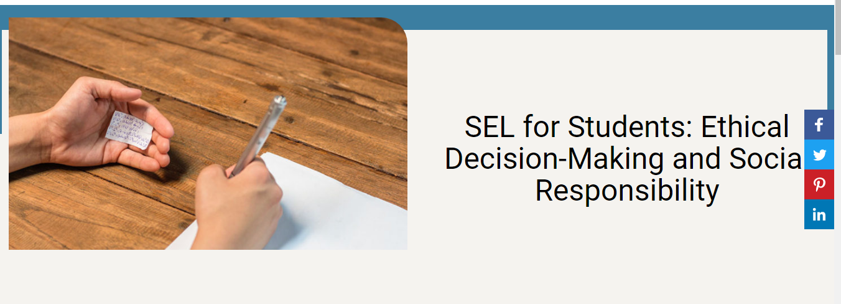
Social Emotional Learning (SEL)
Examples (United States)
1.27

Slide 22
Social Emotional Learning (SEL)
Implementation in Columbia County
Missing SEL Page from CCBOE.net
SEL (google.com)
SEL Vision and Mission
1.10, 1.25

Slide 23
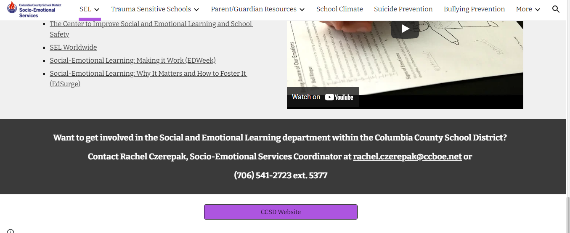
Social Emotional Learning (SEL)
Implementation in Columbia County

Slide 24
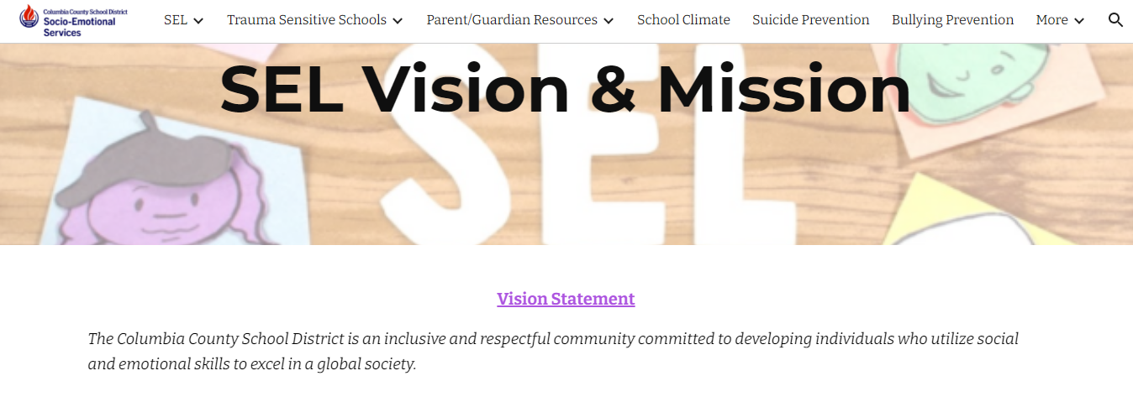
Social Emotional Learning (SEL)
Implementation in Columbia County

Slide 25
Social Emotional Learning (SEL)
Implementation in Columbia County

Slide 26
Social Emotional Learning (SEL)
Concerns/Questions
Who decides “social norms” for which to set student expectations?
By what standard is the SEL framework based on? Given the numerous social emotional components, who is setting the standard for “most favorable” responses?
What if parents don’t agree with the standards set for “most favorable” responses?
What is the effect on children if the morals they are taught at home conflict with what SEL teaches?

Slide 27
CASEL
Background
Funding
Ties to SEL
Marketed vs. Reality
Examples
Implementation in Columbia County
Concerns/Questions

Slide 28
CASEL
Background
CASEL-Collaborative for Academic, Social, and Emotional Learning
Mission: To help make evidence-based social and emotional learning an integral part of education from preschool through high school; supports states, districts, and schools and convenes leading thinkers to ensure SEL is a priority in every school; committed to advancing equity and excellence in education through SEL
2.6

Slide 29
CASEL
Background (continued)
Emerged from a meeting in 1994 hosted by the Fetzer Institute; attendees included researchers, educators, and child advocates involved in various education-based efforts
Served as a coordination effort to combine drug prevention, violence prevention, sex education, civic education, and moral education programs
Gained traction and helped spread SEL throughout schools
2.6

Slide 30
CASEL
Background
Original CASEL is NOT new CASEL
Gradual transition over time
Definition changed in 2020:
Previous definition: “The process through which children and adults acquire and effectively apply knowledge, attitudes, and skills they need to understand and manage emotions, set and accomplish positive goals, feel and show empathy for others, establish and maintain positive relationships, and make responsible decisions.
2.3, 2.6

Slide 31
CASEL
Background (continued)
New definition Part I:
“Social and emotional learning (SEL) is an integral part of education and human development. SEL is the process through which all young people and adults acquire and apply the knowledge, skills, and attitudes to develop healthy identities, manage emotions and achieve personal and collective goals, feel and show empathy for others, establish and maintain supportive relationships, and make responsible and caring decisions.”
2.3, 2.6

Slide 32
CASEL
Background (continued)
New definition Part II:
“SEL advances educational equity and excellence through authentic school-family-community partnerships to establish learning environments and experiences that feature trusting and collaborative relationships, rigorous and meaningful curriculum and instruction, and ongoing evaluation. SEL can help address various forms of inequity and empower young people and adults to co-create thriving schools and contribute to safe, healthy, and just communities.”
2.3, 2.6

Slide 33
CASEL
Funding
Bill & Melinda Gates Foundation
Chan Zuckerberg Initiative
NoVo Foundation
The Allstate Foundation
LG Electronics USA
PureEdge, INC
Raikes Foundation
2.5

Slide 34
CASEL
Funding (continued)
Bill & Melinda Gates Foundation
“Nonprofit fighting poverty, disease, and inequity around the world.”
February 2021-provided one million dollars as a grant to fund a curriculum sponsored by equitablemath.org, which seeks to dismantle racism in mathematics
2.5, 2.7, 2.8, 2.9

Slide 35
CASEL
Funding (continued)
Chan Zuckerberg Initiative:
“We believe in an education system grounded in racial equity… To do this, the K-12 education system must be transformed by… expanding the definition of student success beyond academics to include both well being and academic achievement… centering the voices of Black, Brown, and Indigenous students and their caregivers in decisions about how the education system can help students flourish and thrive.
2.5, 2.12

Slide 36
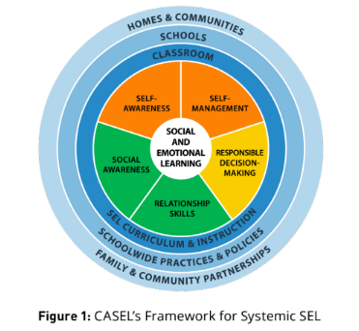
CASEL
Ties to SEL
2.1, 2.2

Slide 37
CASEL
Ties to SEL
2.6

Slide 38
CASEL
“CASEL is a trusted source for knowledge about high-quality, evidence-based social and emotional learning (SEL). CASEL supports educators and policy leaders and enhances the experiences and outcomes for all PreK-12 students.”
Marketed:
www.casel.org/about-2/
“We believe that there is no system more important than education for fighting against racism. And we believe that our work in social and emotional learning must actively contribute to anti-racism...SEL can move people from anger to agency, and then to action...and we see SEL as a tool for anti-racism.”
Reality:
Karen Niemi, CASEL President & CEO,
SEL As a Lever for Equity and Social Justice webinar
2.3, 2.6

Slide 39
CASEL
Examples (United States)
2.13, 2.14

Slide 40
CASEL
Implementation in Columbia County
2.15

Slide 41
CASEL
Concerns/Questions
Transformative SEL as a Lever for Equity & Social Justice (casel.org)
Version 1 August 2021

Slide 42
Critical Race Theory (CRT)
Background
Funding
Ties to SEL
Marketed vs. Reality
Examples
Implementation in Columbia County
Concerns/Questions

Slide 43
Critical Race Theory (CRT)
Background – Core Principles
Essentially a lens in which all things are taught or experienced in a way that relates it to “oppressor and oppressed”
An assumption that racism is “endemic” to American life
A belief that “legal neutrality, objectivity, color-blindness, and meritocracy” are tools of dominant groups
3.4

Slide 44
Critical Race Theory (CRT)
Background
Stems from critical theory and critical social justice, with origins in
Marxism
Belief that American society and its institutions are systemically racist and need to be reimagined or dismantled
Individuals are either victims or privileged; “lived experiences” matter more than facts.
3.4

Slide 45
Critical Race Theory (CRT)
Background (continued)
Spread into education field with the early work of Ladson-Billings and colleague William F. Tate IV
In education, CRT advocates focus on what is seen to be persistent instances of white supremacy, as characterized by phenomena such as “colorblindness, meritocracy, deficit thinking, linguicism, and other forms of subordination”
Example: curriculum is “a culturally specific artifact designed to maintain a White Supremacist master script.”
3.4

Slide 46
Critical Race Theory (CRT)
Background (continued)
The many concepts of CRT:
Affinity Groups
Anti-Racism
Color-blindness
Critical Race Theory
Culturally Responsive Teaching
Equity
1619 Project
Implicit Bias
Meritocracy
Microaggression
Restorative Justice
White Fragility
White Supremacy
Diversity, Equity & Inclusion
3.4, 3.5

Slide 47
Critical Race Theory (CRT)
Background (continued) – Equality vs Equity
3.7

Slide 48
Critical Race Theory (CRT)
Background (continued) – Equity is NOT Equality
Equity demands equal outcomes vs equal opportunities
Assumes all disparate outcomes are a result of flawed and racist systems; does not take other factors into account
Applies to judicial, educational, legal, health systems, etc
Answer lies in transferring resources from “oppressors” to “oppressed”
3.10, 3.13

Slide 49
Critical Race Theory (CRT)
Background (continued) – Equality vs Equity
“Everyone seems to want more resources… but when resources are finite a strategic approach must be used to yield the greatest impact for all students. School leaders may find it a tough pill to swallow to learn that they won’t be getting additional funding as other schools may be next year because their students are performing well. Why would success ever become a disincentive? A school system isn’t an economic system, and performance excellence should be its own reward. School leaders should be proud to get great results with resources previously allocated.” - Illuminate Education eBook
3.16

Slide 50
Critical Race Theory (CRT)
Funding
Black Lives Matter
National Education Association Teachers Union
Zinn Education Project

Slide 51
Critical Race Theory (CRT)
Funding (continued)
Black Lives Matter
3.17

Slide 52
Critical Race Theory (CRT)
Funding (continued)
Black Lives Matter Co-Founder Patrisse Cullors describes her organization as “trained Marxists”
Original Black Lives Matter website (now removed) stated:
“We disrupt the Western-prescribed nuclear family structure requirement by supporting each other as extended families and “villages” that collectively care for one another, especially our children, to the degree that mothers, parents, and children are comfortable.”
3.11, 3.12

Slide 53
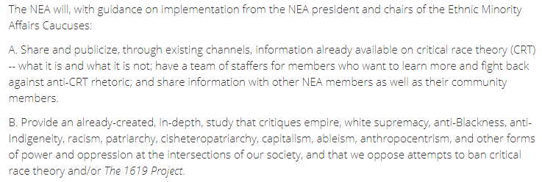
Critical Race Theory (CRT)
Funding (continued)
National Education Association Teachers Union
3.19

Slide 54
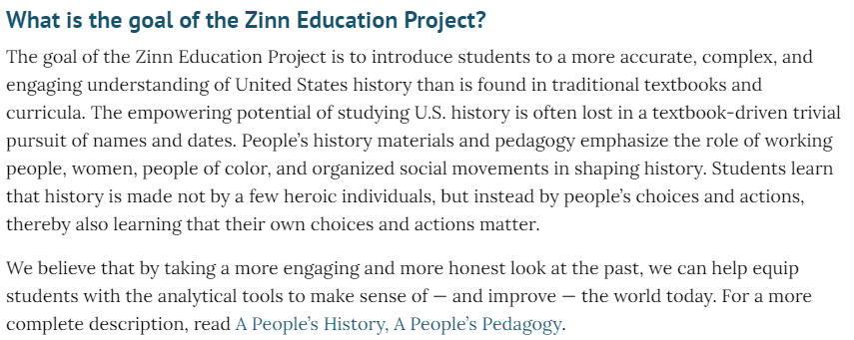
Critical Race Theory (CRT)
Funding (continued)
Zinn Education Project
3.18

Slide 55
Critical Race Theory (CRT)
Funding – Federal Government
Today the Department is posting the Notices Inviting Applications for this year’s American History and Civics grant competitions. The notices include two priorities that are invitational, meaning they encourage applicants to address topics that are important to the Department. The first invitational priority encourages projects that incorporate racially, ethnically, culturally, and linguistically diverse perspectives into teaching and learning. This priority is included because the Department recognizes the value of supporting teaching and learning that reflects the rich diversity, identities, histories, contributions, and experiences of all students. As every parent knows, when students can make personal connections to their learning experiences, there are greater opportunities for them to stay engaged in their education and see pathways for their own futures.
A second invitational priority encourages projects that improve students’ information literacy skills. At a time when our democratic institutions are threatened by misinformation and disinformation, our democracy depends on robust civic engagement and informed public discourse, and civics education can help students become better citizens by developing the skills necessary to distinguish between accurate and inaccurate information.
3.1

Slide 56
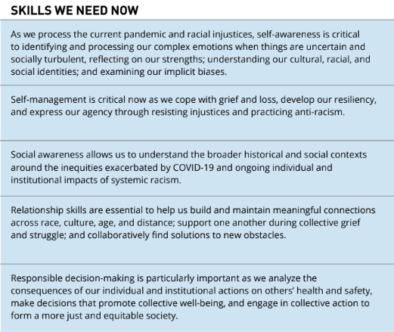
Critical Race Theory (CRT)
Ties to SEL
3.24

Slide 57
Critical Race Theory (CRT)
Ties to SEL
3.24

Slide 58
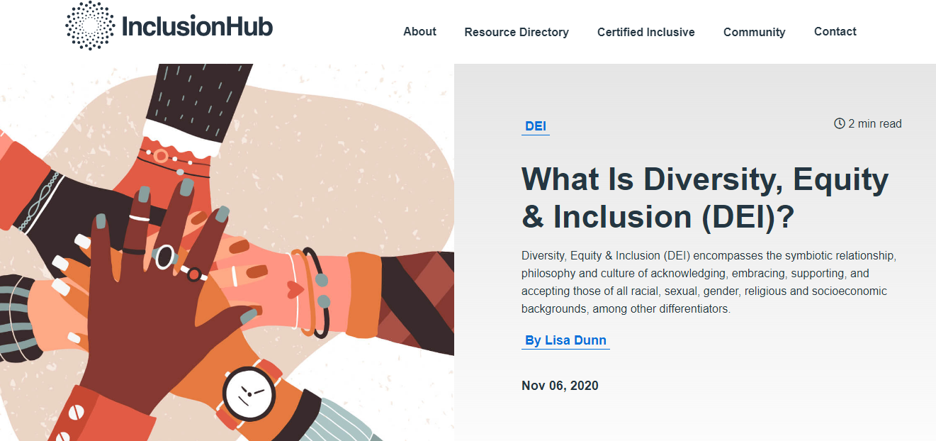
Critical Race Theory (CRT)
Marketed
“Diversity, Equity, & Inclusion encompasses the symbiotic relationship, philosophy, and culture of acknowledging and embracing, supporting, and accepting those of all racial, sexual, gender, religious, and socioeconomic backgrounds, among other difference”
3.14

Slide 59
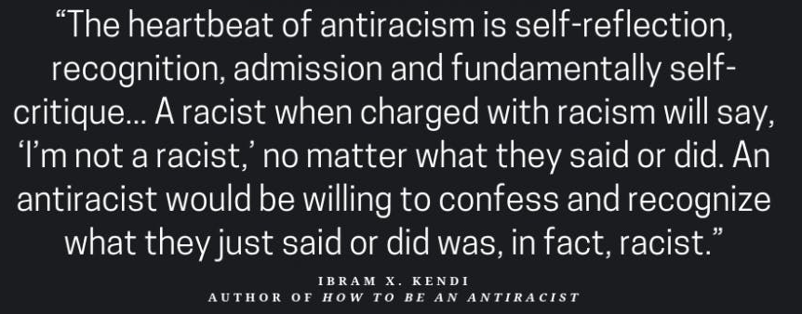
Critical Race Theory (CRT)
Reality

Slide 60
Critical Race Theory (CRT)
Examples (United States) – GA Dept of Education (removed)
3.7

Slide 61
Critical Race Theory (CRT)
Examples (United States) – GA Dept of Education (removed)
3.7

Slide 62
Critical Race Theory (CRT)
Examples (United States) – GA Dept of Education (removed)
3.7

Slide 63
Critical Race Theory (CRT)
Examples (United States) – GA Dept of Education (removed)
3.7

Slide 64
Critical Race Theory (CRT)
Examples (United States) – Equity Replacing Equality

Slide 65
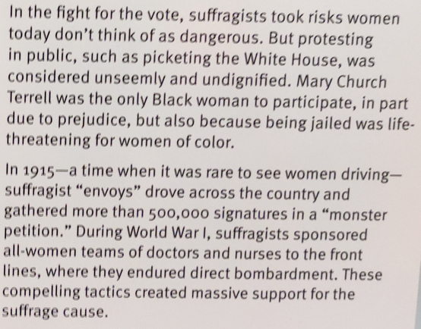
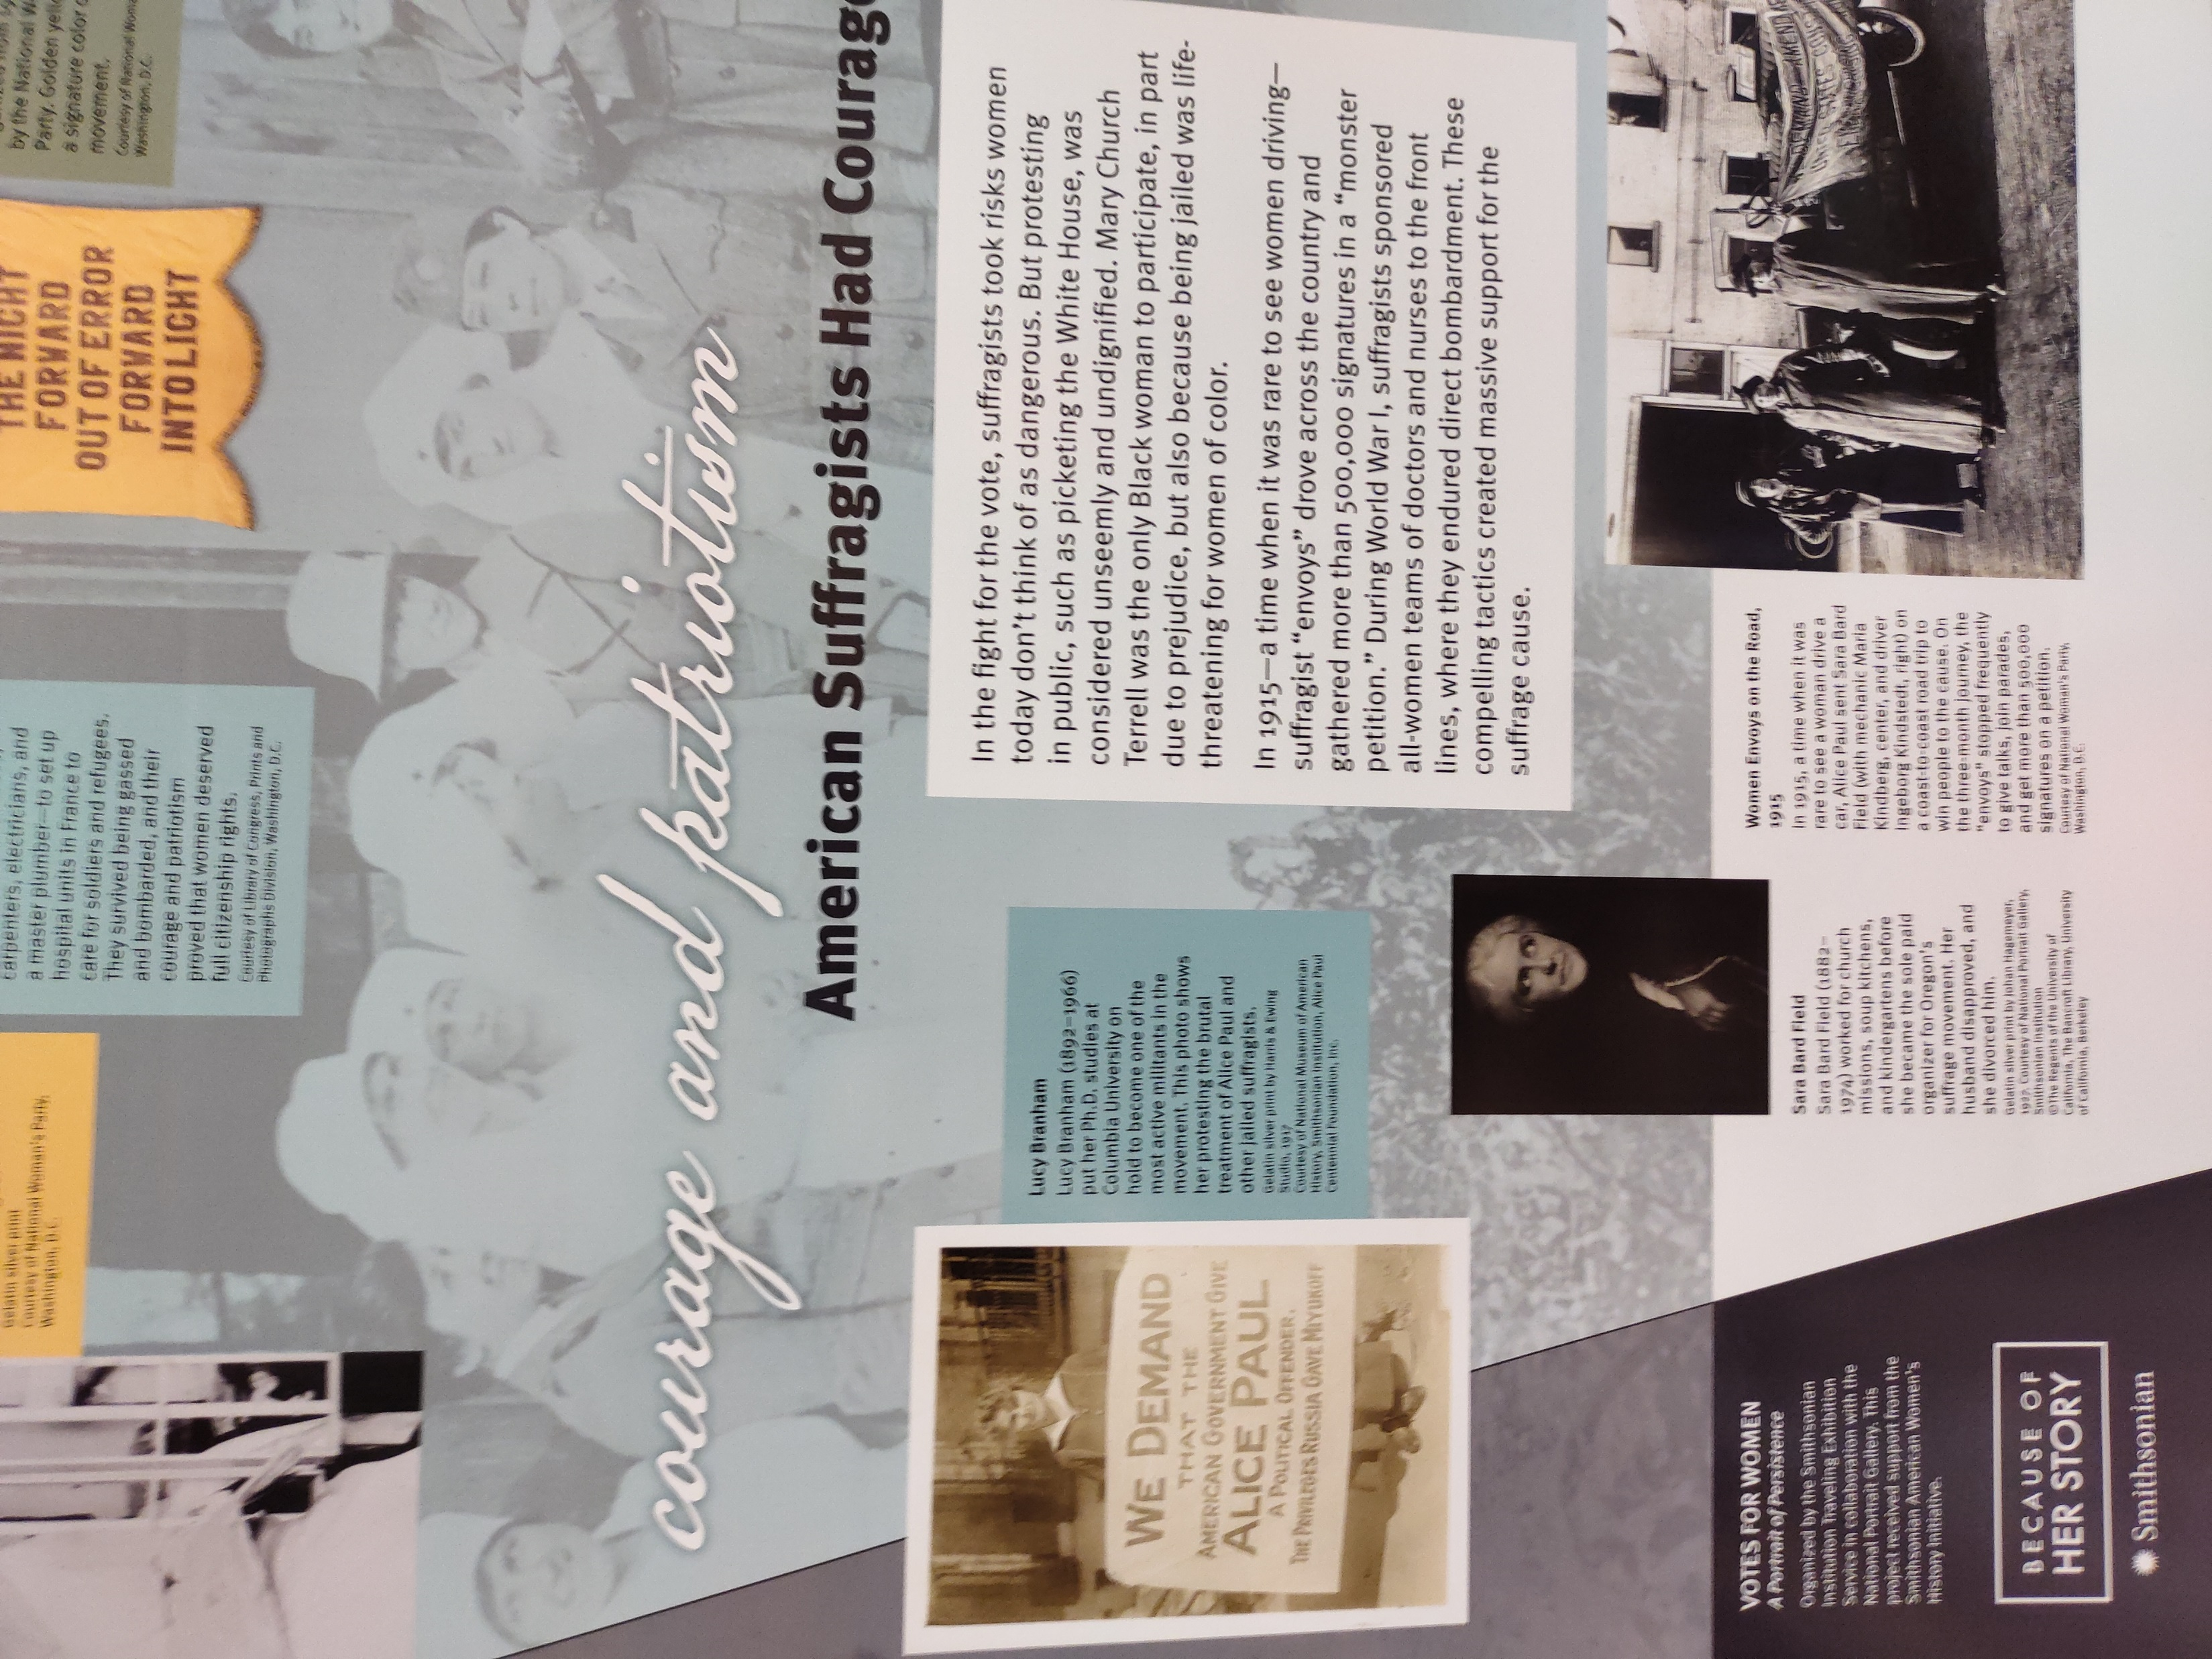
Critical Race Theory (CRT)
Implementation in Columbia County – Hallway Posters

Slide 66
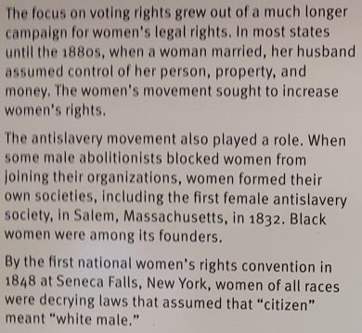
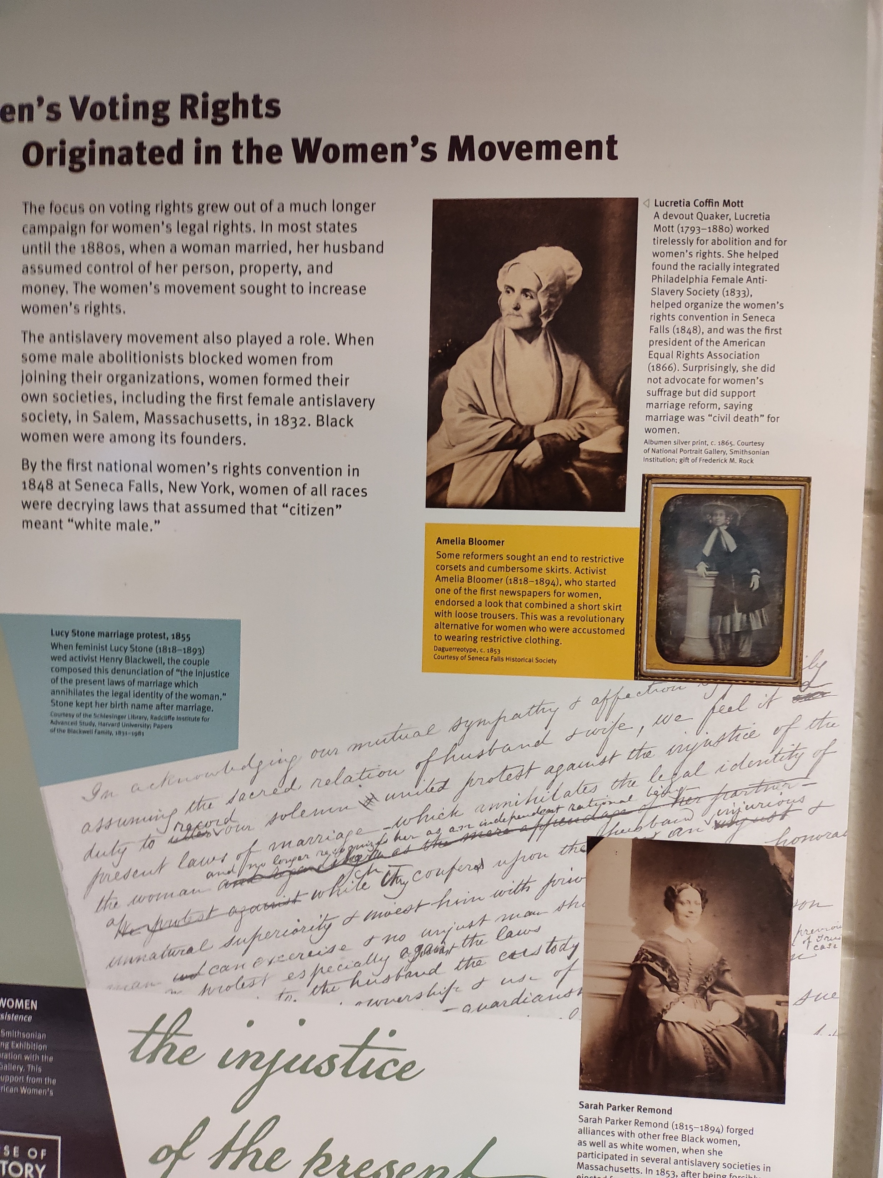
Critical Race Theory (CRT)
Implementation in Columbia County – Hallway Posters

Slide 67
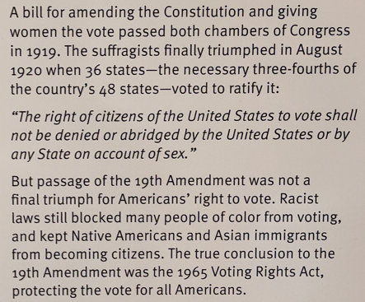
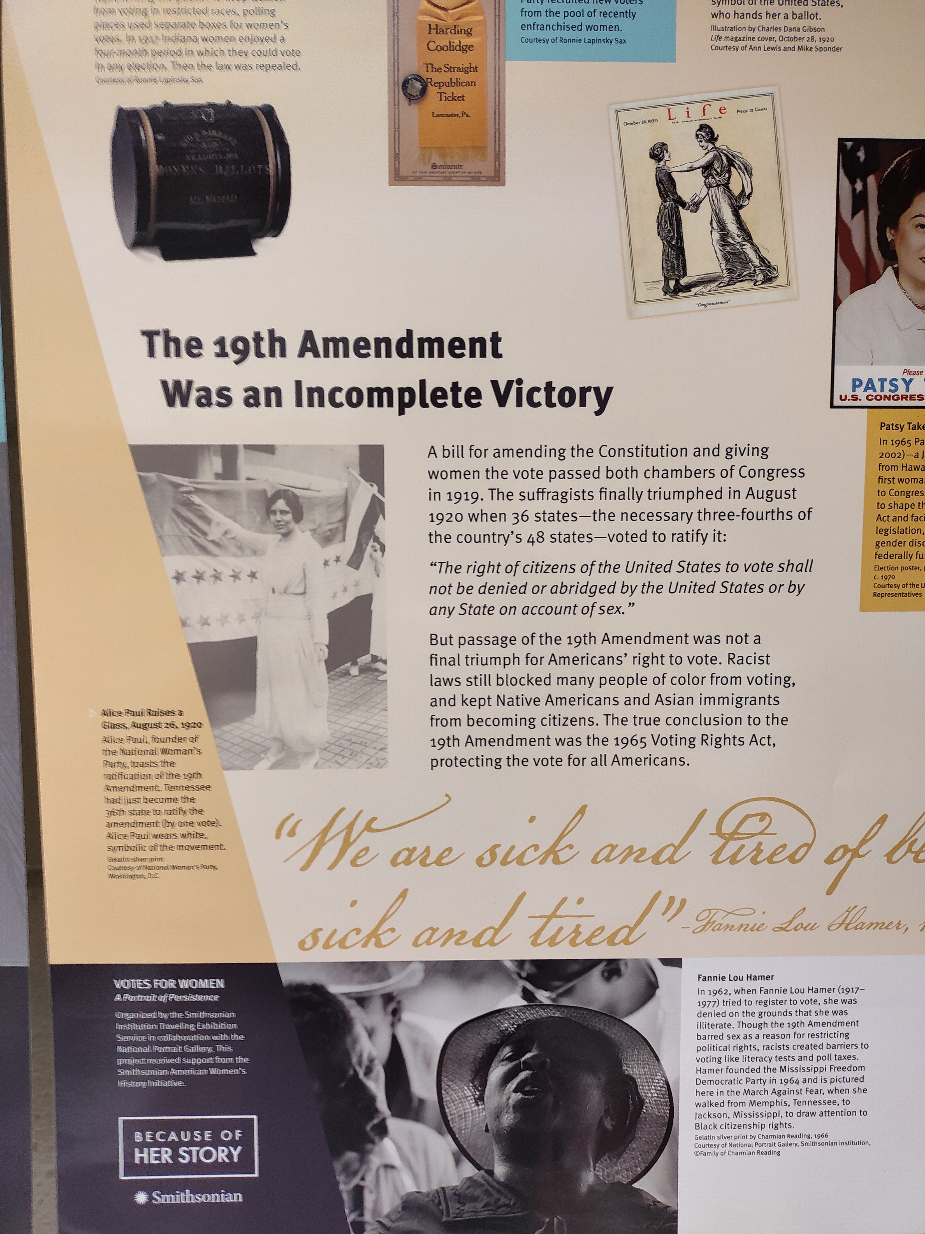
Critical Race Theory (CRT)
Implementation in Columbia County – Hallway Posters

Slide 68
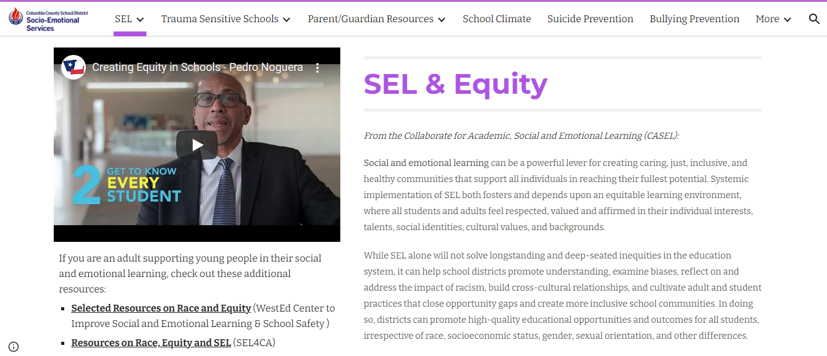
Critical Race Theory (CRT)
Implementation in Columbia County – SEL link (removed)
1.10, 1.25

Slide 69
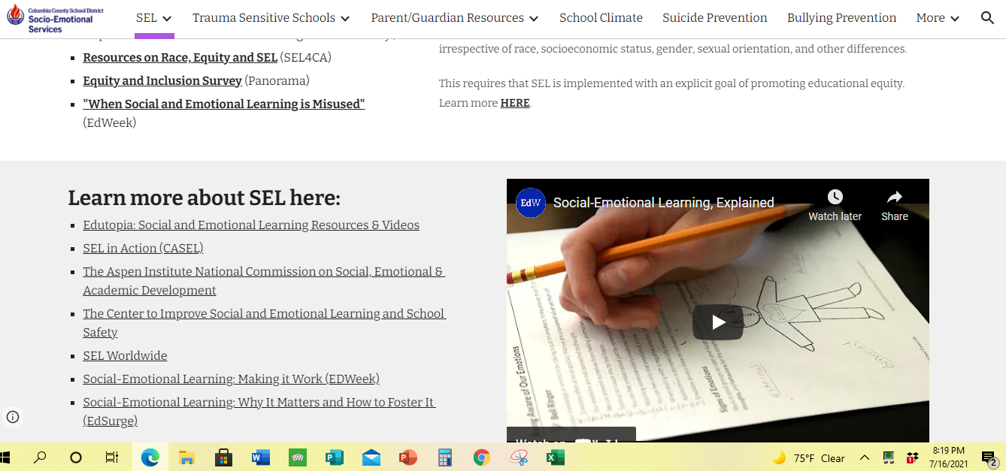
Critical Race Theory (CRT)
Implementation in Columbia County – SEL link (removed)
1.10, 1.25

Slide 70
Critical Race Theory (CRT)
Concerns/Questions
Child activism to dismantle and “fix” racist systems
Ties to Federal Funding
Resources are finite-where does “extra” money come from?
Does teaching CRT positively affect root causes of educational disparity?
Are correlation links in educational outcomes being confused with causation links?

Slide 71
Panorama Survey Tool
Background
Funding
Ties to SEL
Marketed vs. Reality
Examples
Implementation in Columbia County
Concerns/Questions
Notes:
Resources:

Slide 72
Panorama Survey Tool
Background
Panorama Education (Panorama Ed) “partners with K-12 schools and districts across the country to collect and analyze data about social-emotional learning, school climate, family engagement, and more.”
CASEL lists Panorama as a tool for elevating stakeholder voices, gathering data for continuous improvement, and assessing the impact of social-emotional learning each year
4.5
Notes:
Resources:

Slide 73
Panorama Survey Tool
Background
Contains a vast bank of survey questions, which can be selected individually or by category based on school customization
Responses can be viewed in countless ways using the software-age, grade, sex, race, housing status, etc
Student responses compared to national data to determine “ranking” bell curve; schools can track progress points (positive or negative) towards established goals
4.5, 4.11, 4.12, 4.13
Notes:
Resources:

Slide 74
Panorama Survey Tool
Background
Example Goals:
Increase “Student has growth mindset” positive responses from 75% to 85% in two years
Decrease “Student feels overwhelmed at school” positive responses from 60% to 50% in one year
4.5, 4.11, 4.12, 4.13
Notes:
Resources:

Slide 75
Panorama Survey Tool
Background
Individual answers can be tracked as well; can be saved in portfolio that follows student year to year
Software flags high-risk behavior such as anger, aggression, depression, self-harm, etc
Software suggests lessons to improve “scores” towards school goals; lessons created by third party partners
4.5, 4.11, 4.12, 4.13
Notes:
Resources:

Slide 76
Panorama Survey Tool
Background
Panorama User Guide: “ In selecting survey topics and interpreting data about social-emotional learning, it is essential for educators to consider how situational or systemic forces, such as racism and racial bias, shape students' lives and to recognize that students social-emotional growth is the shared responsibility of students, educators, families, and their broader communities.”
4.5
Notes:
Resources:

Slide 77
Panorama Survey Tool
Background
Panorama Playbook: strategies and resources to develop their students' skills and improve classroom/school climate
Provides resources from trusted organizations and curriculum providers, including Second Step, Transforming Education, and Teaching Tolerance (project of the Southern Poverty Law Center);
All use concepts of CRT, DEI, etc
4.14
Notes:
Resources:

Slide 78
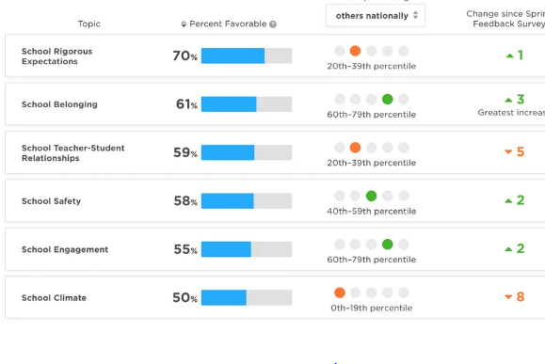
Panorama Survey Tool
4.5, 4.11, 4.12, 4.13
Notes:
Resources:

Slide 79
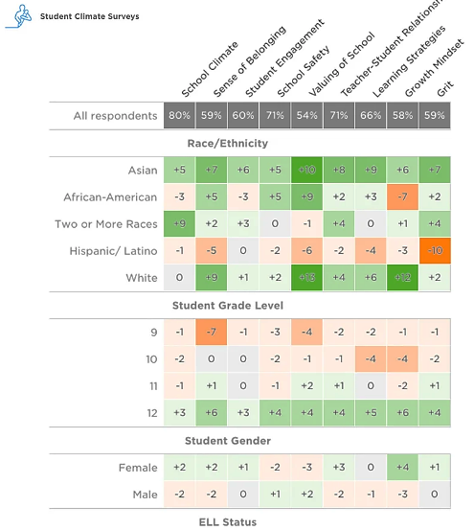
Panorama Survey Tool
4.5, 4.11, 4.12, 4.13
Notes:
Resources:

Slide 80
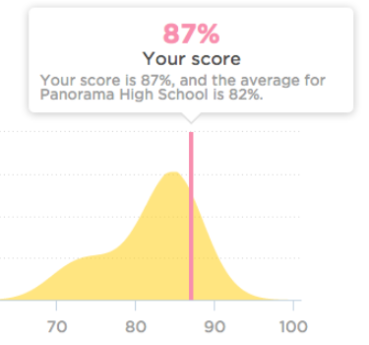
Panorama Survey Tool
4.5, 4.11, 4.12, 4.13
Notes:
Resources:

Slide 81
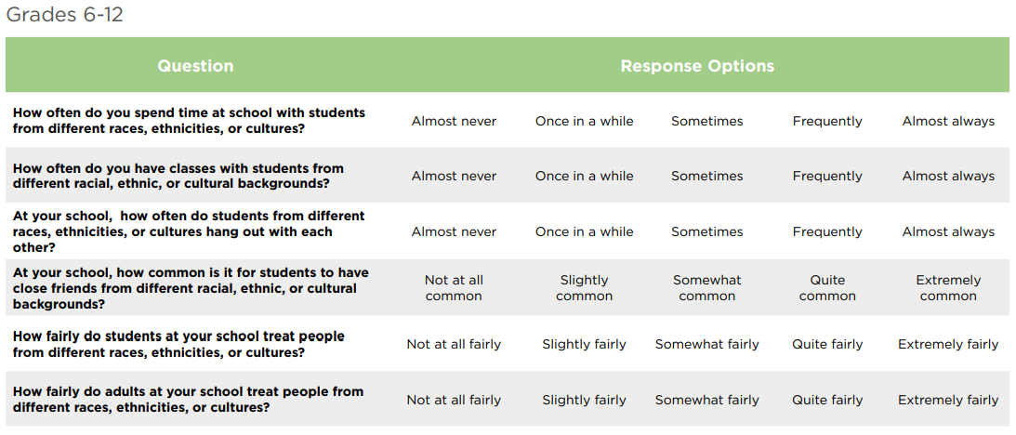
Panorama Survey Tool
Background – Equity & Inclusion Survey Questions
4.14
Notes:
Resources:

Slide 82
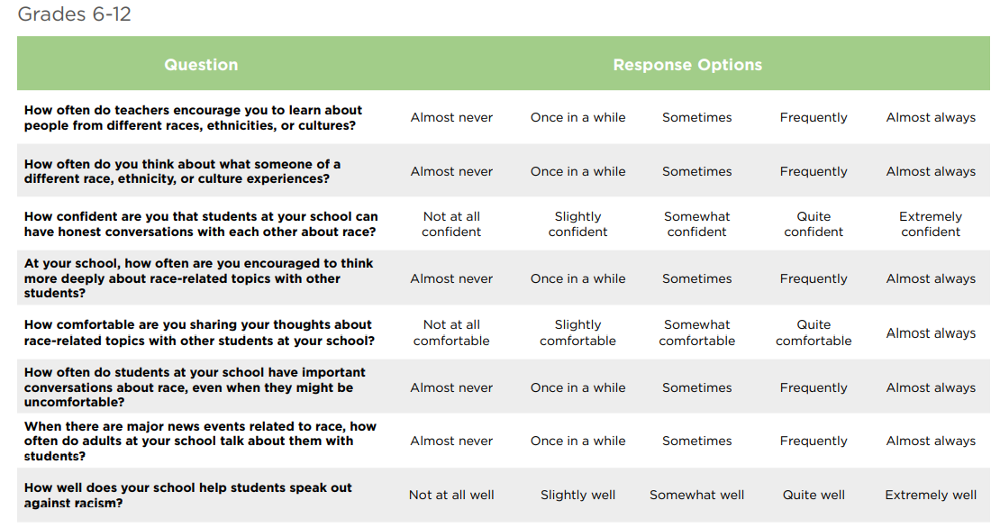
Panorama Survey Tool
Background – Equity & Inclusion Survey Questions
4.14
Notes:
Resources:

Slide 83
Panorama Survey Tool
Background – Third-Party Lessons
4.15, 4.16
Notes:
Resources:

Slide 84
Panorama Survey Tool
Funding
Emerson Collective
Owl Ventures
Chan Zuckerberg Initiative
Spark Capital
SoftTech VC
In-Depth Funding Report HERE
4.8
Notes:
Resources:

Slide 85
Panorama Survey Tool
Funding - Emerson Collective
Laurene Powell Jobs is the co-founder and current member of Board of Directors for Panorama Education
Focus on helping end systemic inequality and injustice
Seeks to re-imagine/remake the calcified systems of society in a way that is grounded in equity and justice
Mission centers on advancing/re-envisioning the future of high school
4.8
Notes:
Resources:

Slide 86
Panorama Survey Tool
Funding - Owl Ventures
A purpose-built global organization to help scale transformative education companies, backed by top global Limited Partners
Seeks visionary entrepreneurs building transformative education companies; at the forefront of this new wave of innovation in education
4.8
Notes:
Resources:

Slide 87
Panorama Survey Tool
Funding - Owl Ventures (Statement)
“The cumulative impact of systemic racism and racial inequalities — against the backdrop of the deaths of George Floyd and other Black Americans — left us feeling both shaken, and outraged. It also served as a much-needed reminder to accelerate the work to be done to improve opportunities for underrepresented minorities in the tech and venture capital communities.”
4.8
Notes:
Resources:

Slide 88
Panorama Survey Tool
Funding – Chan Zuckerberg Initiative
Announced a first round of grants that support organizations leading the way to advance racial equity, diversity, and inclusion
“Embedding a racial equity lens across CZI’s philanthropic areas of focus will help us drive the impact and results that we are all working to achieve… As part of this critical work, we are engaging changemakers, community members, and movement builders with deep expertise and lived experience as partners, helping to shape our strategies and actions.” - Belinda Stubblefield, head of CZI Diversity, Equity, & Inclusion
4.8
Notes:
Resources:

Slide 89
Panorama Survey Tool
Ties to SEL
“In selecting survey topics and interpreting data about social-emotional learning, it is essential for educators to consider how situational or systemic forces, such as racism and racial bias, shape students' lives and to recognize that students social-emotional growth is the shared responsibility of students, educators, families, and their broader communities.” - User Guide: Panorama Social-emotional Learning Survey
4.5
Notes:
Resources:

Slide 90
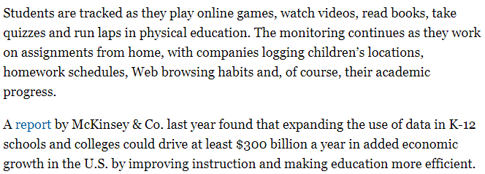
Panorama Survey Tool
Marketed
Reality
4.1, 4.17
Notes:
Resources:

Slide 91
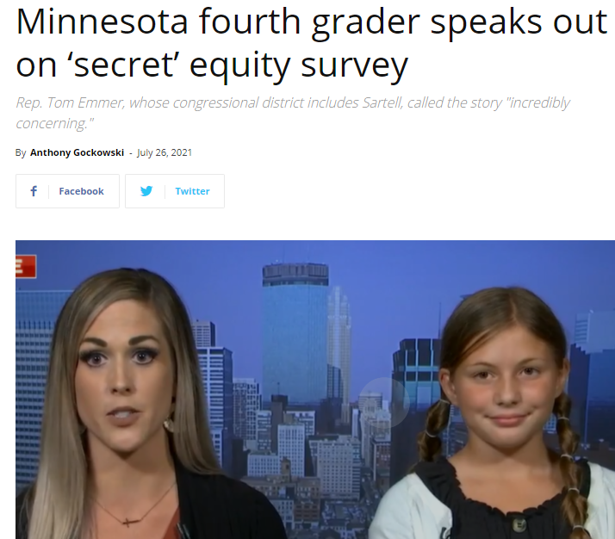
Panorama Survey Tool
Examples - (United States)
4.7
Notes:
Resources:

Slide 92
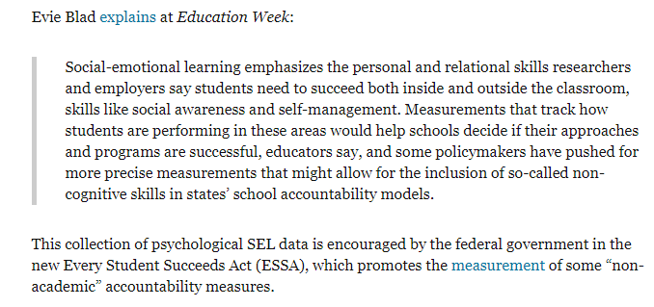
Panorama Survey Tool
Examples - (United States)
4.18
Notes:
Resources:

Slide 93
Panorama Survey Tool
Implementation in Columbia County
Panorama was suspended for this school year thanks to a concerned parent’s extensive research documenting the concerns in this presentation
The following slides show CCBOE’s original intent to implement Panorama
Panorama could be a future concern since this decision was specifically for the 2020-2021 school year
Notes:
Resources:

Slide 94
Panorama Survey Tool
Implementation in Columbia County
4.9
Notes:
Resources:

Slide 95
Panorama Survey Tool
Implementation in Columbia County – SEL link (removed)
1.10, 1.25

Slide 96
Panorama Survey Tool
Concerns/Questions
Can student responses be viewed as accurate measurements of performance?
What assurance is there that students will answer personal surveys honestly?
If students do not answer accurately, will the data be inaccurate as well, therefore rendering the surveys ineffective despite the cost of investment?
Notes:
Resources:

Slide 97
Panorama Survey Tool
Concerns/Questions
What topics/questions are being used in the CC Panorama Survey?
Will the report results be stored in the student’s official school file, whether paper or electronically? Will it follow them? Will this information be released to other schools if students transfer to another school district? Beyond high school to college? Etc.
What steps have been taken to protect our children's privacy?
Notes:
Resources:

Slide 98
Panorama Survey Tool
Concerns/Questions
What policies are in place to protect student's social-emotional answers within the school district?
Which staff have access to survey answers?
Given the provider partners with Panorama have a CRT focus, will all of the student interventions be available for parents to review?
Notes:
Resources:

Slide 99
Panorama Survey Tool
Concerns/Questions
What if the school-identified “favorable” answer on this survey conflicts with parent values/what parents are teaching their children, resulting in an intervention being contrary to the teachings in the home?
This is a strong possibility given the critical pedagogy and equity lens that Panorama utilizes.
Notes:
Resources:

Slide 100
Panorama Survey Tool
Concerns/Questions
Teachers: Will CC Schools be reporting teacher responses by any of the following and if so, which ones?
1. Years of Experience
2. Gender
3. Race/Ethnicity
Notes:
Resources:

Slide 101
Comprehensive Sexual Education (CSE)
Background
Funding
Ties to SEL
Marketed vs. Reality
Examples
Implementation in Columbia County
Concerns/Questions
Notes:
Resources:

Slide 102
Comprehensive Sexual Education (CSE)
Background
Emerging standard for schools; defined as a holistic, developmental and age appropriate, culturally and contextually relevant and scientifically accurate learning process grounded in a vision of human rights, gender equality, sex positivity and citizenship that is aimed at:
Empowering children and young people to uphold their own rights and the rights of others and to contribute to achieving an equal, diverse, compassionate and just society
Enabling children and young people to make decisions about their health and access key sexual and reproductive health services
5.14
Notes:
Resources:

Slide 103
Comprehensive Sexual Education (CSE)
Background
World Health Organization states that the concept of sexual health includes three basic elements:
A capacity to enjoy and control sexual and reproductive behavior in accordance with a social and personal ethic;
Freedom from fear, shame, guilt, false beliefs, and other psychological factors inhibiting sexual response and impairing sexual relationship; and
Freedom from organic disorders, diseases, and deficiencies that interfere with sexual and reproductive functions.
5.28
Notes:
Resources:

Slide 104
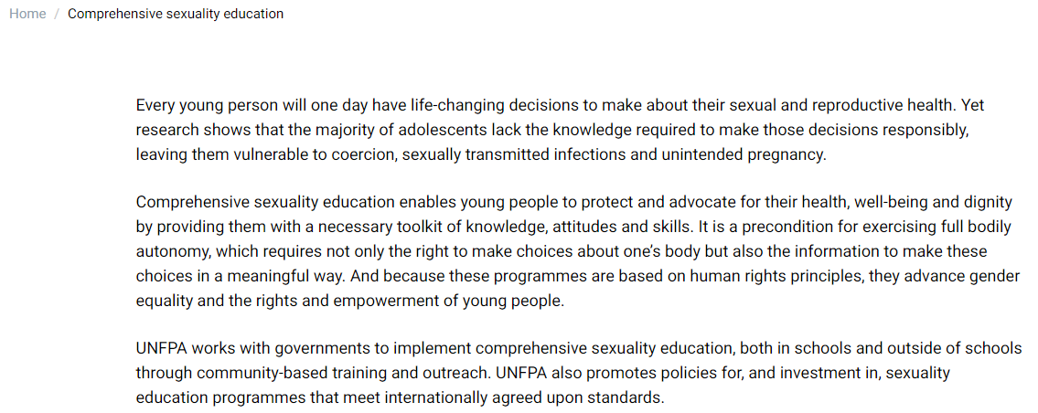
Comprehensive Sexual Education (CSE)
Background
United Nations Population Fund
5.41
Notes:
Resources:

Slide 105
Comprehensive Sexual Education (CSE)
Funding/Providers
Federal Grants
Planned Parenthood
Advocates for Youth
SIECUS: Sex Ed for Social Change
Answer (The Trevor Project)
FoSE (Future of Sex Education Initiative)
National Sexuality Education Standards
Notes:
Resources:
Arcus Foundation | Push Boundaries. Make Change.
NoVo Foundation | Find Grantmakers & Nonprofit Funders | Foundation Directory Online (foundationcenter.org)

Slide 106
Comprehensive Sexual Education (CSE)
Funding - Federal Grants
2009 - Obama administration transferred funds from the Community-based Abstinence Education Program; budgeted $190 million in new funding for two new sex education initiatives:
Teen Pregnancy Prevention Program (TPPP)
Personal Responsibility Education Program (PREP)
2015 – Additional 81 grantees were funded through TPPP
5.28
Notes:
Resources:
Arcus Foundation | Push Boundaries. Make Change.
NoVo Foundation | Find Grantmakers & Nonprofit Funders | Foundation Directory Online (foundationcenter.org)

Slide 107
Comprehensive Sexual Education (CSE)
Funding – Planned Parenthood
Largest provider of sexual education in the US; also largest provider of abortions and contraceptives
Founder: Eugenicist Margaret Sanger
Trained over 20,000 professionals including counselors, teachers, and medical professionals, religious leaders, public health workers, and other human service providers.
2015 - Affiliates were awarded federal grants totaling nearly $22 million per year for five years.
5.28
Notes:
Resources:
Arcus Foundation | Push Boundaries. Make Change.
NoVo Foundation | Find Grantmakers & Nonprofit Funders | Foundation Directory Online (foundationcenter.org)

Slide 108
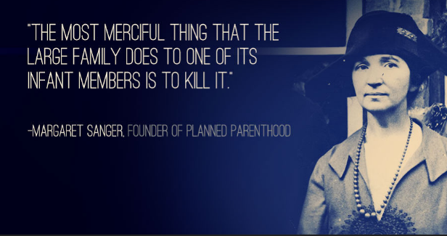
Comprehensive Sexual Education (CSE)
Funding – Planned Parenthood
Notes:
Resources:
Arcus Foundation | Push Boundaries. Make Change.
NoVo Foundation | Find Grantmakers & Nonprofit Funders | Foundation Directory Online (foundationcenter.org)

Slide 109
Comprehensive Sexual Education (CSE)
Funding – Planned Parenthood
5.22
Notes:
Resources:
Arcus Foundation | Push Boundaries. Make Change.
NoVo Foundation | Find Grantmakers & Nonprofit Funders | Foundation Directory Online (foundationcenter.org)

Slide 110
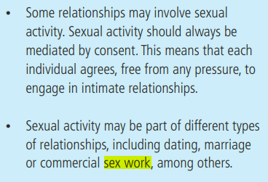
Comprehensive Sexual Education (CSE)
Funding – Planned Parenthood
5.14
Notes:
Resources:
Arcus Foundation | Push Boundaries. Make Change.
NoVo Foundation | Find Grantmakers & Nonprofit Funders | Foundation Directory Online (foundationcenter.org)

Slide 111
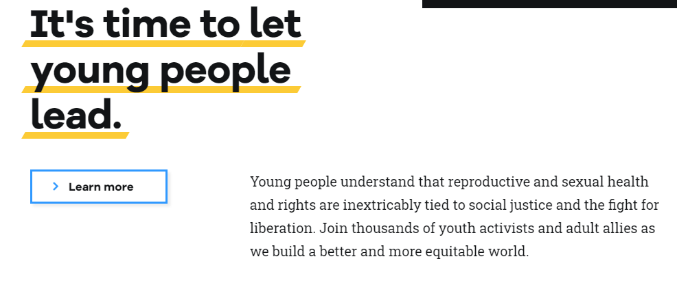
Comprehensive Sexual Education (CSE)
Funding – Advocates for Youth
5.16
Notes:
Resources:
Arcus Foundation | Push Boundaries. Make Change.
NoVo Foundation | Find Grantmakers & Nonprofit Funders | Foundation Directory Online (foundationcenter.org)

Slide 112
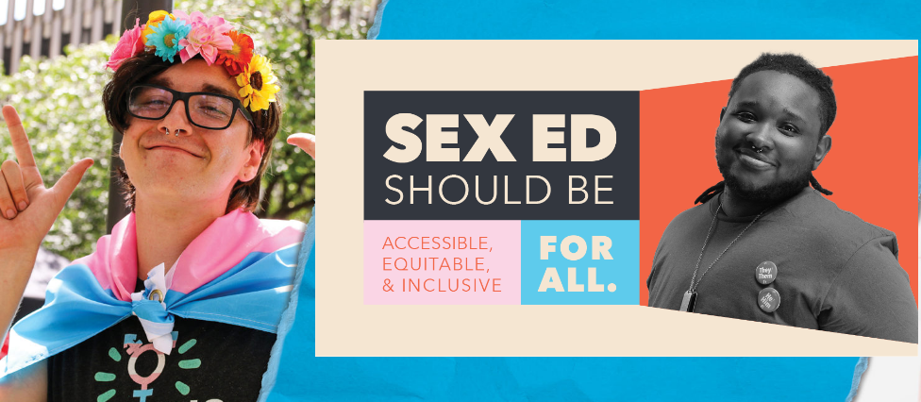
Comprehensive Sexual Education (CSE)
Funding – Sex Ed for Social Change (SIECUS)
5.18
Notes:
Resources:
Arcus Foundation | Push Boundaries. Make Change.
NoVo Foundation | Find Grantmakers & Nonprofit Funders | Foundation Directory Online (foundationcenter.org)

Slide 113
Comprehensive Sexual Education (CSE)
Funding – Answer (The Trevor Project)
5.17
Notes:
Resources:
Arcus Foundation | Push Boundaries. Make Change.
NoVo Foundation | Find Grantmakers & Nonprofit Funders | Foundation Directory Online (foundationcenter.org)

Slide 114
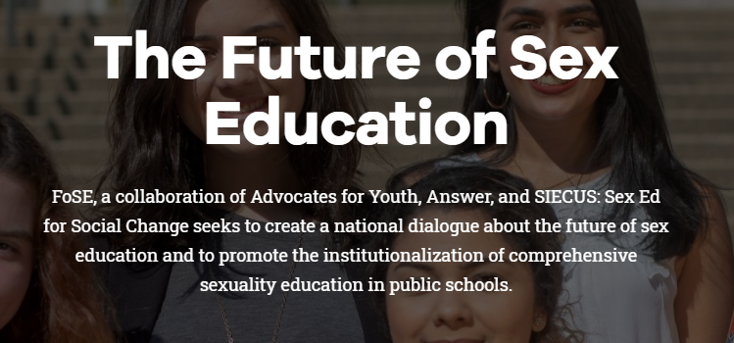
Comprehensive Sexual Education (CSE)
Funding – Future of Sex Ed Initiative (FoSE)
5.19
Notes:
Resources:
Arcus Foundation | Push Boundaries. Make Change.
NoVo Foundation | Find Grantmakers & Nonprofit Funders | Foundation Directory Online (foundationcenter.org)

Slide 115
Comprehensive Sexual Education (CSE)
Funding – National Sexuality Education Standards
Published by FoSE
Established “core competencies” for sexuality education by grade level, K-12th Grade
Ex: By 2nd grade, a child should be able to define bodily autonomy, consent, and identify types of families (e.g., nuclear, single parent, blended, intergenerational, cohabitating, adoptive, foster, same-gender, interracial); define gender, gender identity, gender role stereotypes; define reproduction
5.20
Notes:
Resources:
Arcus Foundation | Push Boundaries. Make Change.
NoVo Foundation | Find Grantmakers & Nonprofit Funders | Foundation Directory Online (foundationcenter.org)

Slide 116
Comprehensive Sexual Education (CSE)
Funding – National Sexuality Education Standards
EX: By 5th grade, children should understand sexual feelings, to include masturbation; should understand hormone blockers as an option for transgender children; distinguish between sex assigned at birth and gender identity; explain gender identity as a spectrum; know all gender terms (cisgender, nonbinary, etc); demonstrate ways to show dignity and respect for all genders and sexual orientations in one’s community
5.20
Notes:
Resources:
Arcus Foundation | Push Boundaries. Make Change.
NoVo Foundation | Find Grantmakers & Nonprofit Funders | Foundation Directory Online (foundationcenter.org)

Slide 117
Comprehensive Sexual Education (CSE)
Funding – National Sexuality Education Standards
EX: By 8th grade, children should describe how power differences, such as age, gender, socioeconomic status, immigration status, race, or unequal position may impact relationships; Analyze how peers, family, and a person’s intersecting identities can influence attitudes, beliefs, and expectations about gender identity/sexual orientation; Develop a plan for the school to promote dignity and respect for people of all gender identities/sexual orientations; Access reliable sources of information for these topics
5.20
Notes:
Resources:
Arcus Foundation | Push Boundaries. Make Change.
NoVo Foundation | Find Grantmakers & Nonprofit Funders | Foundation Directory Online (foundationcenter.org)

Slide 118
Comprehensive Sexual Education (CSE)
Funding – National Sexuality Education Standards
EX: By 8th grade (cont), children should be able to define vaginal, oral, and anal sex; Define sexual identity and explain a range of identities related to sexual orientation (e.g., heterosexual, bisexual, lesbian, gay, queer, twospirit, asexual, pansexual); List at least four methods of contraception that are available without a prescription; know state laws for minor access to confidential health care consultations; identify options for terminating pregnancy
5.20
Notes:
Resources:
Arcus Foundation | Push Boundaries. Make Change.
NoVo Foundation | Find Grantmakers & Nonprofit Funders | Foundation Directory Online (foundationcenter.org)

Slide 119
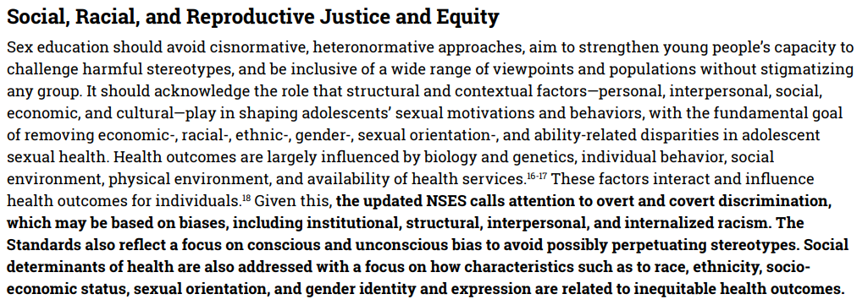
Comprehensive Sexual Education (CSE)
Funding – National Sexuality Education Standards
5.20
Notes:
Resources:
Arcus Foundation | Push Boundaries. Make Change.
NoVo Foundation | Find Grantmakers & Nonprofit Funders | Foundation Directory Online (foundationcenter.org)

Slide 120
Comprehensive Sexual Education (CSE)
Funding – National Sexuality Education Standards
5.20
Notes:
Resources:
Arcus Foundation | Push Boundaries. Make Change.
NoVo Foundation | Find Grantmakers & Nonprofit Funders | Foundation Directory Online (foundationcenter.org)

Slide 121
Comprehensive Sexual Education (CSE)
Funding – National Sexuality Education Standards
5.20
Notes:
Resources:
Arcus Foundation | Push Boundaries. Make Change.
NoVo Foundation | Find Grantmakers & Nonprofit Funders | Foundation Directory Online (foundationcenter.org)

Slide 122
Comprehensive Sexual Education (CSE)
Funding – National Sexuality Education Standards
Example Lesson Plan:
5.8
Notes:
Resources:
Arcus Foundation | Push Boundaries. Make Change.
NoVo Foundation | Find Grantmakers & Nonprofit Funders | Foundation Directory Online (foundationcenter.org)

Slide 123
Comprehensive Sexual Education (CSE)
Ties to SEL
5.29
Notes:
Resources:

Slide 124
Comprehensive Sexual Education (CSE)
Ties to SEL
5.26
Notes:
Resources:

Slide 125
Comprehensive Sexual Education (CSE)
Marketed vs. Reality
5.30
Notes:
Resources:

Slide 126
Comprehensive Sexual Education (CSE)
Marketed vs. Reality
5.30
Notes:
Resources:

Slide 127
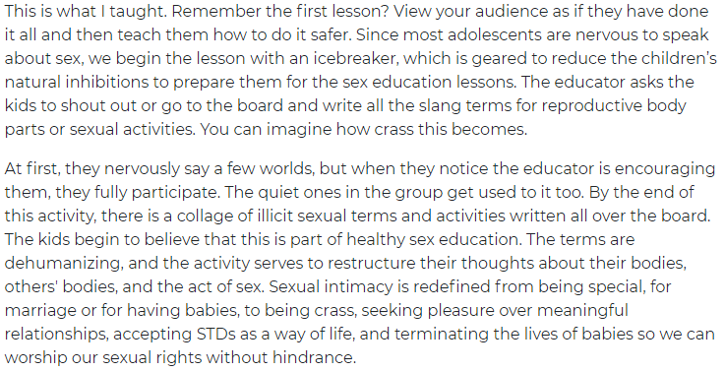
Comprehensive Sexual Education (CSE)
Marketed vs. Reality
5.30
Notes:
Resources:

Slide 128
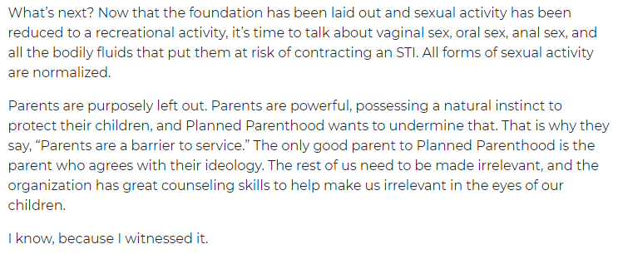
Comprehensive Sexual Education (CSE)
Marketed vs. Reality
5.30
Notes:
Resources:

Slide 129
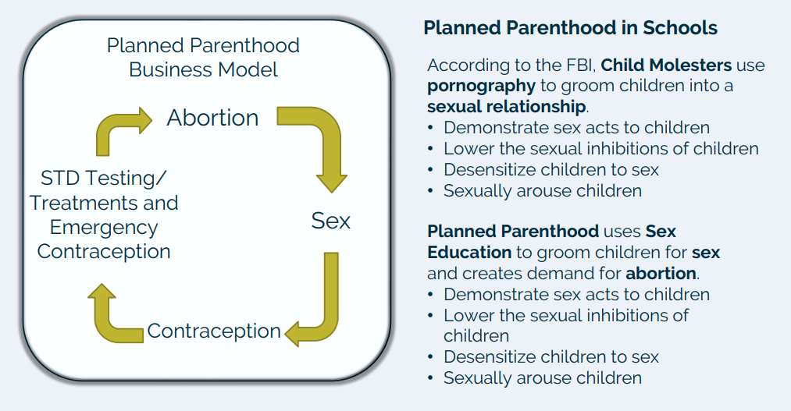
Comprehensive Sexual Education (CSE)
Marketed vs. Reality
5.31
Notes:
Resources:

Slide 130
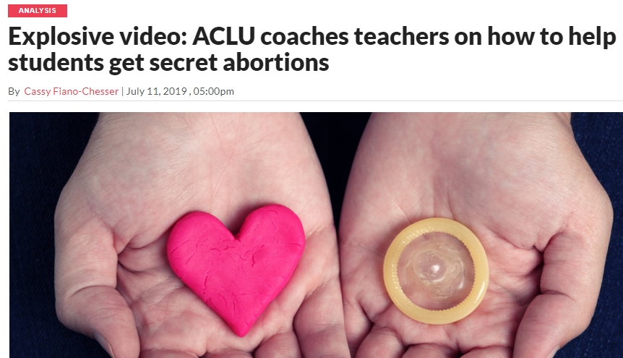
Comprehensive Sexual Education (CSE)
Examples – United States
5.32
Notes:
Resources:
Law Firm Claims Wisconsin School District Violated State Law By Providing Students With ‘Sexually Explicit’ Books | The Daily Wire
Report: ‘Sexually explicit’ books for 3rd-graders at Elmbrook – Empower Wisconsin

Slide 131
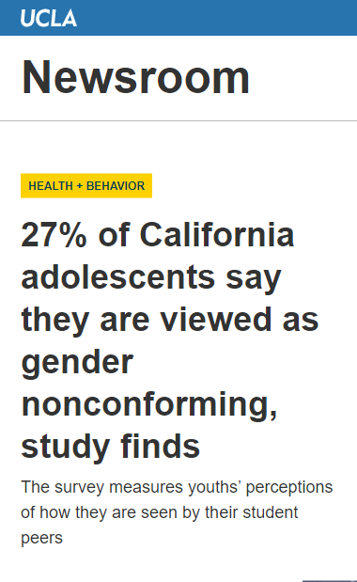
Comprehensive Sexual Education (CSE)
Examples – United States
5.6, 5.11, 5.12
Notes:
Resources:
Law Firm Claims Wisconsin School District Violated State Law By Providing Students With ‘Sexually Explicit’ Books | The Daily Wire
Report: ‘Sexually explicit’ books for 3rd-graders at Elmbrook – Empower Wisconsin

Slide 132
Comprehensive Sexual Education (CSE)
Examples – United States
5.32, 5.33
Notes:
Resources:
Law Firm Claims Wisconsin School District Violated State Law By Providing Students With ‘Sexually Explicit’ Books | The Daily Wire
Report: ‘Sexually explicit’ books for 3rd-graders at Elmbrook – Empower Wisconsin

Slide 133
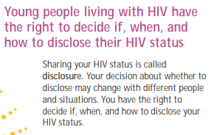
Comprehensive Sexual Education (CSE)
Examples – United States
5.13
Notes:
Resources:
Law Firm Claims Wisconsin School District Violated State Law By Providing Students With ‘Sexually Explicit’ Books | The Daily Wire
Report: ‘Sexually explicit’ books for 3rd-graders at Elmbrook – Empower Wisconsin

Slide 134
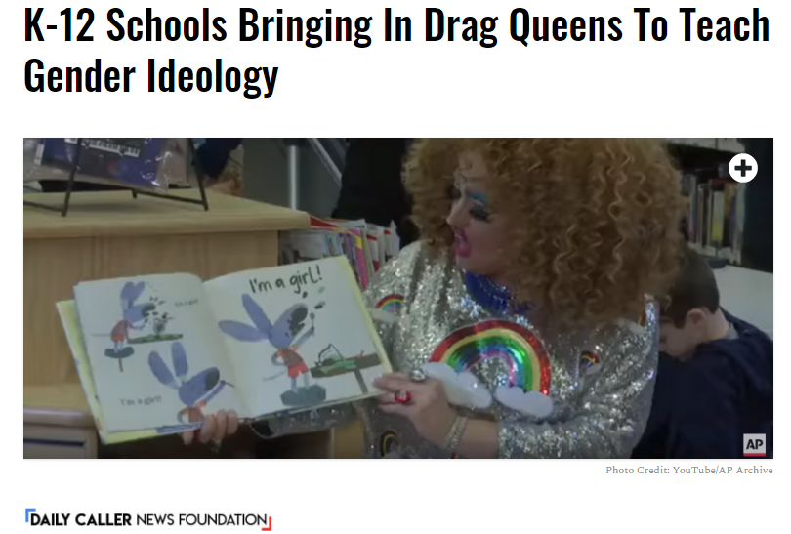
Comprehensive Sexual Education (CSE)
Examples – United States
5.34
Notes:
Resources:
Law Firm Claims Wisconsin School District Violated State Law By Providing Students With ‘Sexually Explicit’ Books | The Daily Wire
Report: ‘Sexually explicit’ books for 3rd-graders at Elmbrook – Empower Wisconsin

Slide 135
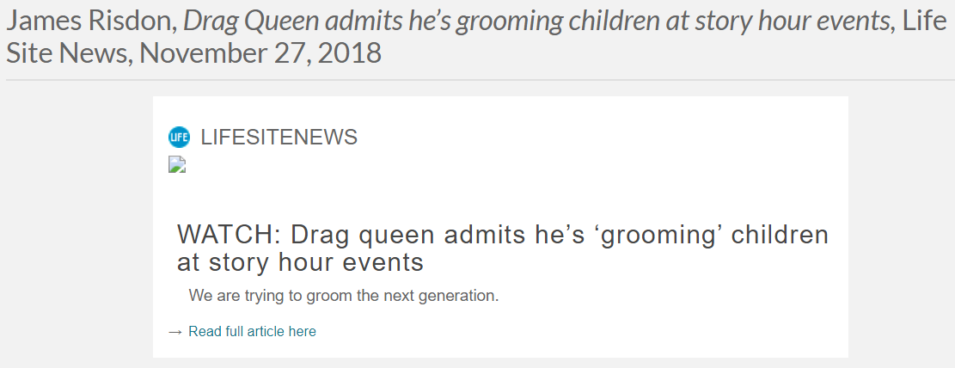
Comprehensive Sexual Education (CSE)
Examples – United States
5.35
Notes:
Resources:
Law Firm Claims Wisconsin School District Violated State Law By Providing Students With ‘Sexually Explicit’ Books | The Daily Wire
Report: ‘Sexually explicit’ books for 3rd-graders at Elmbrook – Empower Wisconsin

Slide 136
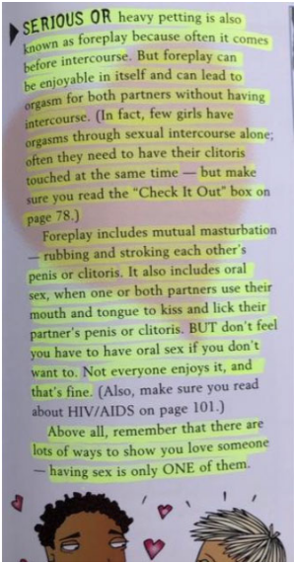
Comprehensive Sexual Education (CSE)
Examples – United States
Screenshot of fifth grade materials included in Positive Prevention Plus provided to The Daily Caller News Foundation
5.27, 5.36
Notes:
Resources:
Law Firm Claims Wisconsin School District Violated State Law By Providing Students With ‘Sexually Explicit’ Books | The Daily Wire
Report: ‘Sexually explicit’ books for 3rd-graders at Elmbrook – Empower Wisconsin

Slide 137
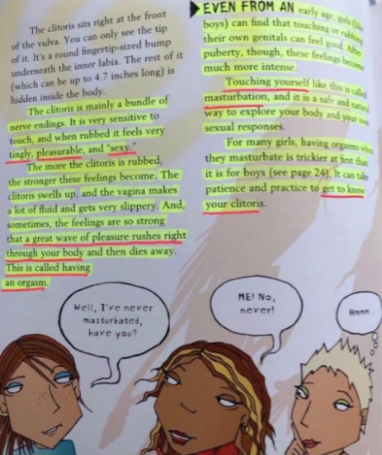
Comprehensive Sexual Education (CSE)
Examples – United States
Screenshot of fifth grade materials included in Positive Prevention Plus provided to The Daily Caller News Foundation
5.27
Notes:
Resources:
Law Firm Claims Wisconsin School District Violated State Law By Providing Students With ‘Sexually Explicit’ Books | The Daily Wire
Report: ‘Sexually explicit’ books for 3rd-graders at Elmbrook – Empower Wisconsin

Slide 138
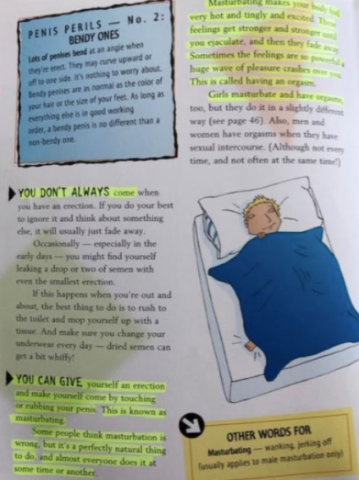
Comprehensive Sexual Education (CSE)
Examples – United States
Screenshot of fifth grade materials included in Positive Prevention Plus provided to The Daily Caller News Foundation
5.27
Notes:
Resources:
Law Firm Claims Wisconsin School District Violated State Law By Providing Students With ‘Sexually Explicit’ Books | The Daily Wire
Report: ‘Sexually explicit’ books for 3rd-graders at Elmbrook – Empower Wisconsin

Slide 139
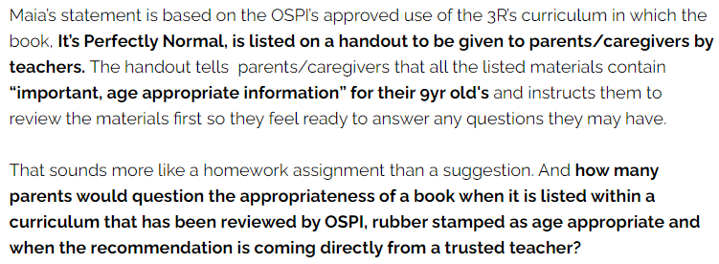
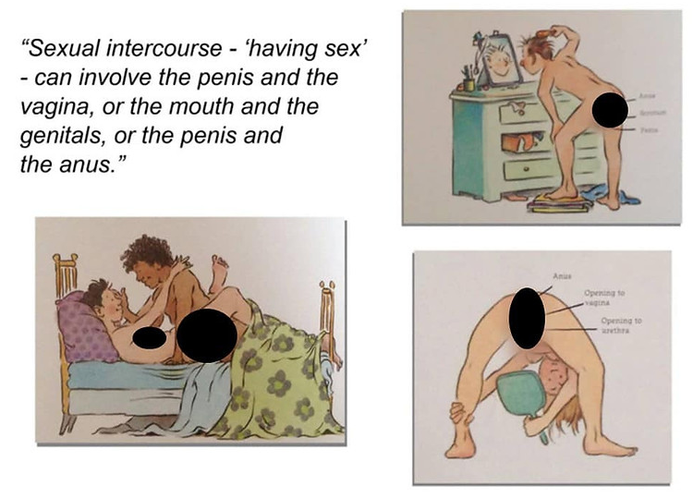
Comprehensive Sexual Education (CSE)
Examples – United States
5.50
Notes:
Resources:

Slide 140
Comprehensive Sexual Education (CSE)
Implementation in Columbia County
CCBOE does not list these particular education programs at this time
CCBOE does have sexually sensitive material in libraries to include pornographic, LGBT, and transgender content
CCBOE does support LGBT training and student outreach programs
5.23, 5.25
Notes:
Resources:

Slide 141
WARNING: THE FOLLOWING TWO SLIDES CONTAIN SEXUALLY EXPLICIT MATERIAL FOUND IN COLUMBIA COUNTY SCHOOL LIBRARIES
Notes:
Resources:

Slide 142
Comprehensive Sexual Education (CSE)
Implementation in Columbia County - Media Center Titles
Hannah took off her shirt and let Justin put his hands up her bra… She came over to my table at lunch, whispered the proposition in my ear, and I had a hard on for the rest of the day… I’ve had my ass grabbed before-no big deal… “Oh my God!” she screamed, “He’s cramming his dick in his pants.”… Don’t worry; Mrs. Crimsen, I thought. No boys in here. No alcohol. No drugs. No fun.
Thirteen Reasons Why, found in Greenbrier, Harlem, Evans, Lakeside, and Grovetown High Schools, as well as Columbia Middle School:
5.25
Notes:
Resources:

Slide 143
Comprehensive Sexual Education (CSE)
Implementation in Columbia County - Media Center Titles
He pinned her hands over her head and ground his hips against hers. Ashe could feel his erection, hot against her stomach… She clawed at Matt’s back to bring him closer, “Yeah,” he groaned, and he pushed her thighs apart. And then suddenly Matt was inside her, pumping so hard that she scooted backward on the carpet, burning the backs of her legs. “Wait,” Josie said, trying to roll away beneath him, but he clamped his hand over her mouth and drove harder and harder until Josie felt him come. Semen, sticky and hot, pooled on the carpet beneath her. Nineteen Minutes, found in Evans, Harlem, and Greenbrier High Schools
5.25
Notes:
Resources:

Slide 144
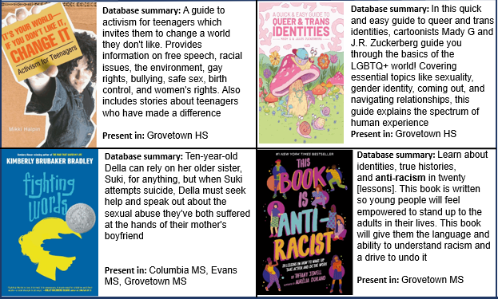
Comprehensive Sexual Education (CSE)
Implementation in Columbia County – Media Center Titles
5.23
Notes:
Resources:

Slide 145
Comprehensive Sexual Education (CSE)
Implementation in Columbia County – Faculty Training
5.23
Notes:
Resources:

Slide 146
Comprehensive Sexual Education (CSE)
Implementation in Columbia County
5.23
Notes:
Resources:

Slide 147
Comprehensive Sexual Education (CSE)
CSE in Georgia – GCAPP
Georgia Campaign for Adolescent Power and Potential (GCAPP) provided CSE in 37 counties reaching 182,000 students in 2020
Goal is to have CSE in 80 counties and reach 360,000 students by 2025
Faith Community
Philanthropic Community
Social Services
Youth Advocates
K-12 Schools
Nonprofit Agencies
Georgia Support Ecosystem
Parents & Families
Government
Higher Education
Corporations
GCAPP
Formula for Change
5.42
Notes:
Resources:

Slide 148
Comprehensive Sexual Education (CSE)
Concerns/Questions
Sexuality taught to children without prior parental approval
Teaching children to access birth control without prior parental approval
Parental values for sex/sexuality vs. school values
Transgenderism spreading amongst young girls
Bathrooms/locker rooms determined by sex vs gender
Notes:
Resources:
Law Firm Claims Wisconsin School District Violated State Law By Providing Students With ‘Sexually Explicit’ Books | The Daily Wire
Report: ‘Sexually explicit’ books for 3rd-graders at Elmbrook – Empower Wisconsin

Slide 149
Comprehensive Sexual Education (CSE)
Concerns/Questions
When forms are done by gender, biological sex is unknown
Example: Columbia County 4H summer camp, July 2021
14-year old female was in female-assigned cabin
One female claimed to be non-binary; appeared to be male
14-year old called parents to inform of the possibility of a male in the cabin
Parents spoke with counselors who were unable to confirm if child was biologically female or male
Notes:
Resources:
Law Firm Claims Wisconsin School District Violated State Law By Providing Students With ‘Sexually Explicit’ Books | The Daily Wire
Report: ‘Sexually explicit’ books for 3rd-graders at Elmbrook – Empower Wisconsin

Slide 150
Why Should You Care?
As a parent…
What if school values on societal topics don’t match family values?
What if schools don’t inform parents if values conflict?
What does an activist child look like?
As a taxpayer…
What is the return on investment of SEL resources and surveys?
Does the SEL program address root causes of data patterns?
What if school values on societal topics don’t reflect community values?
What does a generation of activist children look like?
Notes:
Resources:

Slide 151
What Can You Do?
As a parent…
Create your own opt-out forms to send to teachers and principals (attached in resources)
Talk to your child about reporting any concerning topics at school
Opt your child out of the Panorama survey
Ask your school for a copy of the Panorama survey questions
Be engaged-ask questions to teachers, counselors, principals, county board members, and anyone involved in educating your child
Network with other parents to learn what they are experiencing in their schools
Notes:
Resources:

Slide 152
What Can You Do?
As a taxpayer…
Attend school board meetings; speak if you have questions/concerns
Request meetings with faculty and school board personnel to address concerns (contact information on next slide)
Request details of how tax money is being spent
Ask where funding comes from and any obligations tied to it
Consider joining advocate groups
Consider running for elected positions
Support legislative efforts at county, state, and national levels
Notes:
Resources:

Slide 153
What Can You Do?
Meet Your CCBOE Employees:
Dr. Steve Flynt (Superintendent)
(706) 541-2723 steven.flynt@ccboe.net
Michele Sherman (Associate Superintendent)
(706) 541-2723 ext.5235 michele.sherman@ccboe.net
Kelly Tyson (Social Emotional Learning Coordinator)
(706) 541-2723 ext.5335 kelly.tyson@ccboe.net
Marcus Allen (Director of School Climate)
(706) 541-2723 ext.5237 marcus.allen@ccboe.net
Full List: Administration – About Us – Columbia County Schools (ccboe.net)
Notes:
Resources:

Slide 154
What Can You Do?
Meet Your School Board
Notes:
Resources:

Slide 155
What Can You Do?
Meet Your School Board
Notes:
Resources:

Slide 156
What Can You Do?
Meet Your School Board
Notes:
Resources:

Slide 157
What Can You Do?
Meet Your School Board
Notes:
Resources:

Slide 158
What Can You Do?
Meet Your School Board
Notes:
Resources:

Slide 159
Resources- General
Protect Student Health Georgia (LINK)
Tool Kit contains opt-out forms
No Left Turn in Education (LINK)
What Are They Learning (LINK)
Parents Defending Education (LINK)
US Parents Involved in Education (LINK)
Child and Parental Rights Campaign (LINK)
GA Open Records Request (LINK)

Slide 160
Resources – Start Here
Critical Race Theory & Gender Ideology - by Abigail Shrier - The Truth Fairy (substack.com)
Critical Race Theory and its Influence in GA Education
Navigating The Transgender Landscape.pdf
NSES-2020-web.pdf (advocatesforyouth.org)
Inclusive_Sex_Education.pdf (plannedparenthood.org)
Panorama Equity and Inclusion User Guide.pdf (panoramaed.com)
https://www.fearlessfeatures.org/themindpolluters

Slide 161
Resources-SEL
1.1 Equity and SEL - Casel Schoolguide
1.2 CRT-SEL-Comparison_Updated-11-20-20.pdf (netdna-ssl.com)
1.3 Problems with Social-Emotional Learning in K-12 Education | New Study (pioneerinstitute.org)
1.4 Study-New Age Nanny State (document)
1.5 SEL-New Age Nanny State (video)
1.6 ‘Social-Emotional Learning’: New Education Fad, Same As The Old Fads (thefederalist.com)
1.8 Georgia Vision Project (document)
1.9 Columbia County BoE 26JUL2021 Meeting Notes (document)
1.10 Columbia County SEL page (documented before removal)
1.11 Grow Strong Roots Social-Emotional Learning (therootedschool.com)
1.12 Back to School: Students Primed for ‘Social and Emotional Learning’ While Failing in Math and Reading (breitbart.com)

Slide 162
Resources-SEL (cont)
1.13 Frameworks-DevSEL.pdf (casel.org)
1.14 History of SEL — Social Emotional Learning in School - SEL - Grey New community connectors
1.16 ERIC - EJ125585 - No-Fault Problem Solving, Gerontologist, 1975 (ed.gov)
1.17 2021 Back-to-School Guide.pdf (hubspotusercontent30.net)
1.18 How to Secure Funding for Your Social and Emotional Learning (SEL) Program - Social and Emotional Learning - Aperture Education
1.19 NEA Foundation Vision - Improve Public Education for Students
1.20 Note from Elizabeth - How Can We Ensure SEL Is Anti-Racist | Children's Institute (childrensinstitute.net)
1.22 Inspire-Paper-Transforming-Ed-FINAL-2.pdf (transformingeducation.org)

Slide 163
Resources-SEL (cont)
1.23 Systemic SEL Core Competencies.pdf - Google Drive
1.24 Social Policy Report V26, #4: Social and Emotion Learning in Schools: From Programs to Strategies (ed.gov)
1.25 CCBOE Original SEL Page with Links (Document)
1.26 Our Founder | The Fetzer Institute
1.27 Home Page | Greater Good In Education (berkeley.edu)
1.28 https://www.cdc.gov/healthyschools/wscc/index.htm

Slide 164
Resources-CASEL
2.1 CASEL-SEL-Framework-11.2020.pdf
2.2 A Reintroduction to SEL: CASEL’s Definition and Framework – YouTube
2.3 Niemi: CASEL Is Updating the Most Widely Recognized Definition of Social-Emotional Learning. Here’s Why | The 74 (the74million.org)
2.5 Supporters – CASEL
2.6 https://casel.org/
2.7 Bill & Melinda Gates Foundation - Bill & Melinda Gates Foundation
2.8 Math Suffers From White Supremacy, According to a Bill Gates-Funded Course (newsweek.com)
2.9 Homepage - Math Equity Toolkit (equitablemath.org)
2.10 Transformative SEL as a Lever for Equity & Social Justice (casel.org)
2.11 Report: Biden Education Department Encouraged Schools To Use COVID Relief Funds On ‘Social Emotional Learning’ | The Daily Wire

Slide 165
Resources-CASEL
2.12 Home - Chan Zuckerberg Initiative
2.13 Back to School: Students Primed for ‘Social and Emotional Learning’ While Failing in Math and Reading (breitbart.com)
2.14 Texas School District Pilots 4X Daily Recess for Emotional Learning (breitbart.com)
2.15 Kelly Tyson Email

Slide 166
Resources-CRT
3.1 HOMEROOM: Dept of Ed blog post: American History and Civics in Our Schools - ED.gov Blog
3.2 SEL is CRT – YouTube
3.3 Abolitionist Teaching and the Future of Our Schools – YouTube
3.4 Glossary of Terms (Document)
3.5 Excerpts from Woke Schooling (Document)
3.6 CRT Poster Examples in Columbia County Elementary School
3.7 GA State DEI Slides
3.8 Critical Race Theory / Social Emotion Learning Explained (rumble.com)
3.9 Minnesotans Take ‘Propaganda’ of Critical Race Theory to Court (breitbart.com)
3.10 GA State CRT Influence on Education (document)
3.11 Black Lives Matter’s Goal to ‘Disrupt’ the Nuclear Family
3.12 What We Believe - Black Lives Matter (archive.org)

Slide 167
Resources-CRT (cont)
3.13 FULL VERSION_GA State CRT Influence on Education (document)
3.14 What Is Diversity, Equity & Inclusion (DEI)? (inclusionhub.com)
3.15 Microsoft Word - DRAFT Resolution - 21-0602 (eboardsolutions.com)
3.16 Illuminate Education eBook: Ensuring Equitable Outcomes (document)
3.17 About - Black Lives Matter
3.18 Frequently Asked Questions | Teaching History FAQs | What We Get Asked (zinnedproject.org)
3.19 New Business Item 39 - 2021 NEA Annual Meeting (archive.org)
3.20 GA VISION PROJECT Vision-Recommendations-2021 (1).pdf
3.21 SLF Public Comment on Critical Race Theory (slfliberty.org)
3.22 Save Our Schools | Home
3.23 ISL 2019: Knowing Our Worth: A Humanistic Approach... (sched.com)
3.24 CASEL Framework for Systemic SEL
3.25 Equity and SEL - Casel Schoolguide
3.26 Warning to Parents - "Brain Pop" is Just More Political Indoctrination and CRT in Public Schools - Granite Grok

Slide 168
Resources-Panorama Survey
4.1 The big biz of spying on little kids – POLITICOPOLITICOSearchSearchCloseBack
4.2 What You Need to Know About Your Child’s Privacy Rights | Diane Ravitch's blog
4.4 Check-Ins-Question-Bank (panoramaed.com)
4.5 SEL-User-Guide.pdf (panorama-www.s3.amazonaws.com)
4.6 Zuck's first major ed-tech investment? Panorama Education, the brainchild of a Yale coder | VentureBeat
4.7 4th Graders Complete ‘Equity Survey,’ Told Not to Discuss with Parents (breitbart.com)
4.8 Investors to Panama
4.9 Columbia County Testing Schedule
4.10 Meeting with Columbia County RE Panorama-4AUG2021

Slide 169
Resources-Panorama Survey (cont)
4.11 6 Free Templates for Research-Backed Student Survey Questions With PDF Download (panoramaed.com)
4.12 Watch Recorded Sessions from Panorama’s Virtual Summit:A Resilient Reopening! (splashthat.com)
4.13 Panorama Surveys | Panorama Education
4.14 Panorama Equity and Inclusion User Guide.pdf (panoramaed.com)
4.15 SEL Interventions
4.16 Panorama Interventions – 3rd Party Partner Research
4.17 About | Panorama Education
4.18 ESSA Law Broadens Definition of School Success - Education Week (nh.gov)

Slide 170
Resources-Comprehensive Sex Ed
5.1 PSH Parent Toolkit 2021-2022.pdf - Google Drive
5.2 Georgia Department of Education Live Stream – YouTube
5.3 Navigating The Transgender Landscape.pdf
5.4 Censorship | The First Amendment Encyclopedia (mtsu.edu)
5.5 Rights of Teachers | The First Amendment Encyclopedia (mtsu.edu)
5.6 Colorado School District Instructs Teachers To Avoid Informing Parents If Their Child Shows ‘Persistent’ Gender Confusion | The Daily Wire
5.7 NSES-2020-web.pdf (advocatesforyouth.org)
5.8 2-Lesson-1-3Rs-UnderstandingOurBodies.pdf
5.9 Critical Race Theory & Gender Ideology - by Abigail Shrier - The Truth Fairy (substack.com)
5.10 The Totalitarian Agenda Behind LGBT Sex-Ed Revolution at School (theepochtimes.com)

Slide 171
Resources-Comprehensive Sex Ed
5.11 27% of California adolescents say they are viewed as gender nonconforming, study finds | UCLA
5.12 Utah Sees 10,000% Increase in Girls Getting “Sex Change” - The New American
5.13 Happy, Healthy, and Hot: A Young Person’s Guide to their Rights, Sexuality, and Living with HIV
5.14 International Planned Parenthood Fund: Scaling Up CSE
5.15 How Planned Parenthood Teaches Sex Education (plannedparenthoodaction.org)
5.16 Advocates for Youth
5.17 The Trevor Project — Saving Young LGBTQ Lives
5.18 SIECUS: Sex Ed for Social Change
5.19 The Future of Sex Education - Advocates for Youth
5.20 NSES-2020-web.pdf (advocatesforyouth.org)

Slide 172
Resources-Comprehensive Sex Ed
5.21 Non Profits, Full of Radical Leftists, Are Setting National Sex Ed Standards (thegatewaypundit.com)
5.22 Inclusive_Sex_Education.pdf (plannedparenthood.org)
5.23 https://www.refocusoneducation.com/district-content
5.24 Sex Education & Graphic Images for K-5 In Public Schools (deeprootsathome.com)
5.25 Sexual Books in Columbia County School Media Centers
5.26 2021 MS Curriculum Sample - Positive Prevention Plus
5.27 California Implements Extreme New Sex Ed Curriculum (dailysignal.com)
5.28 20170209_sexed_d04_1.pdf (plannedparenthood.org)
5.29 Equity and SEL - Casel Schoolguide
5.30 I was a sex educator trained by Planned Parenthood; here is what I taught your kids | Washington Examiner

Slide 173
Resources-Comprehensive Sex Ed
5.31 Sex Education Overview (cplaction.com)
5.32 Explosive video: ACLU coaches teachers on how to help students get secret abortions (liveaction.org)
5.32 BBC Asks Viewers If There Should Be ‘Age-Appropriate Porn’ For Children | 5.33 The Daily Wire5.33 Dalton parents enraged over 'masturbation' videos for 1st graders (nypost.com)
5.34 K-12 Schools Bringing In Drag Queens To Teach Gender Ideology | The Daily Caller
5.35 WATCH: Drag queen admits he's 'grooming' children at story hour events - LifeSite (lifesitenews.com)
5.36 California school district says parents can’t pull kids from new LGBT sex ed - LifeSite (lifesitenews.com)
5.42 https://www.gcapp.org/wp-content/uploads/2022/01/GCAPPAnnualReport2020.pdf

